Slide 1
Introduction to ELK
RX - M
Software Consulting
A comprehensive introduction to the
Elasticsearch, Logstash, and Kibana FOSS triad also known as the ELK stack.

Slide 2
Objective
This course is designed to give attendees an introductory understanding of the ELK stack (Elasticsearch, Logstash, Kibana) as it relates to analysis and aggregation with a specific focus on Kibana. Upon completion students will have manually installed and configured an ELK system as well as gained direct experience in manipulating the Kibana interface.

Slide 3
Overview
In this course participants will learn how to install, configure, and operationalize the ELK stack with a specific focus on learning Kibana. The ELK Stack is a collection of three open-source products — Elasticsearch, Logstash, and Kibana — from Elastic.
Elasticsearch is a NoSQL database that is based on the Lucene search engine.
Logstash is a log pipeline tool that accepts inputs from various sources, executes different transformations, and exports the data to various targets.
Kibana is a visualization layer that works on top of Elasticsearch.
Together, these three different open source products are most commonly used in log analysis, web analytics, security, and business intelligence. This two day course will introduce students to each of the elements of the ELK stack and give them detailed experience using and extending Kibana.

Slide 4
Agenda
Prerequisites:
Basic proficiency at the command line
Basic proficiency with a flavor of linux
A desire for data
Day 1
Overview
Elasticsearch
Logstash
Kibana
Day 2
ELK in Production
The Kibana Discover Page
The Visualize and Dashboard Pages
Settings and Configuration

Slide 5
Detailed Agenda
Day 1
Overview
What is ELK?
Why we need analysis?
Elasticsearch
Logstash
Kibana
Elasticsearch
Installation
Configuration
Operations
Extending
Tools and Tips
Logstash
Installation
Configuration
Integrations with ES
Operations
Plugins
Other Options
Kibana
Installation
Configuration
Running Kibana
Dashboard
Day 2
ELK in Production
Data loss/data protection
Scaling
Other Considerations
The Kibana Discover Page
Time Filter
Search
More Filters
The Visualize and Dashboard Pages
Aggregations
Various Ranges
Visualizations
Various Charts
Visualizations
Debug Panel
Settings and Configuration
Indices
Saving objects
Additional topics

Slide 6
Administrative Info
Course: Introduction to the ELK Stack – Log analysis solution
Length: 2 Days
Format: Lecture/Labs/Discussion
Schedule: 9:30AM – 5:30PM 15 minute break, AM & PM 1 hour lunch @ noon Lab time at the end of each AM and PM session
Location: Fire exits, Restrooms, Security, other matters
Attendees: Name/Role/Experience/Goals for the Course

Slide 7

Lecture and Lab
Our Goals in this class are two fold:
Familiarize you with the general concepts and ecosystem surrounding the ELK stack
Give you hand-on experience working and configuring the ELK stack

Slide 8

Day 1 Agenda
Copyright 2013-2016, RX-M LLC
Day 1
Overview
Elasticsearch
Logstash
Kibana

Slide 9
Who am I?
Copyright 2013-2016, RX-M LLC
<instructor name>
<instructor email>
<instructor profile/linkedin/etc>
<instructor experience?
<any other relevant instructor link>

Slide 10

Who are you?
Copyright 2013-2016, RX-M LLC
What do you do?
What is your interest in Elasticsearch, Logstash, Kibana?
What is your experience with ELK?
What is important about the ELK stack to you?

Slide 11

11
Copyright 2013-2016, RX-M LLC
Module 1: Overview of the ELK Stack

Slide 12
12
Copyright 2013-2016, RX-M LLC
What is the ELK Stack?
The ELK Stack is a collection of three open-source products — Elasticsearch, Logstash, and Kibana — from Elastic.
Elasticsearch is a NoSQL database that is based on the Lucene search engine.
Logstash is a log pipeline tool that accepts inputs from various sources, executes different transformations, and exports the data to various targets.
Kibana is a visualization layer that works on top of Elasticsearch.
Together, these three different open source products are most commonly used in log analysis in IT environments (though there are many more use cases for the ELK Stack starting including business intelligence, security and compliance, and web analytics). Logstash collects and parses logs, and then Elasticsearch indexes and stores the information. Kibana then presents the data in visualizations that provide actionable insights into one’s environment.

Slide 13
13
Copyright 2013-2016, RX-M LLC
Why is ELK So Popular?
The ELK Stack is popular because it fulfills a need in the log analytics space. Splunk’s enterprise software has long been the market leader, but its numerous functionalities are increasingly not worth the expensive price — especially for smaller companies such as SasS products and tech startups.
For that reason, Splunk has the aforementioned small number of customers while ELK is downloaded more times in a single month than Splunk’s total customer count — and many times over at that. ELK might not have all of the features of Splunk, but it does not need those analytical bells and whistles. ELK is a simple but robust log analysis platform that costs a fraction of the price.

Slide 14
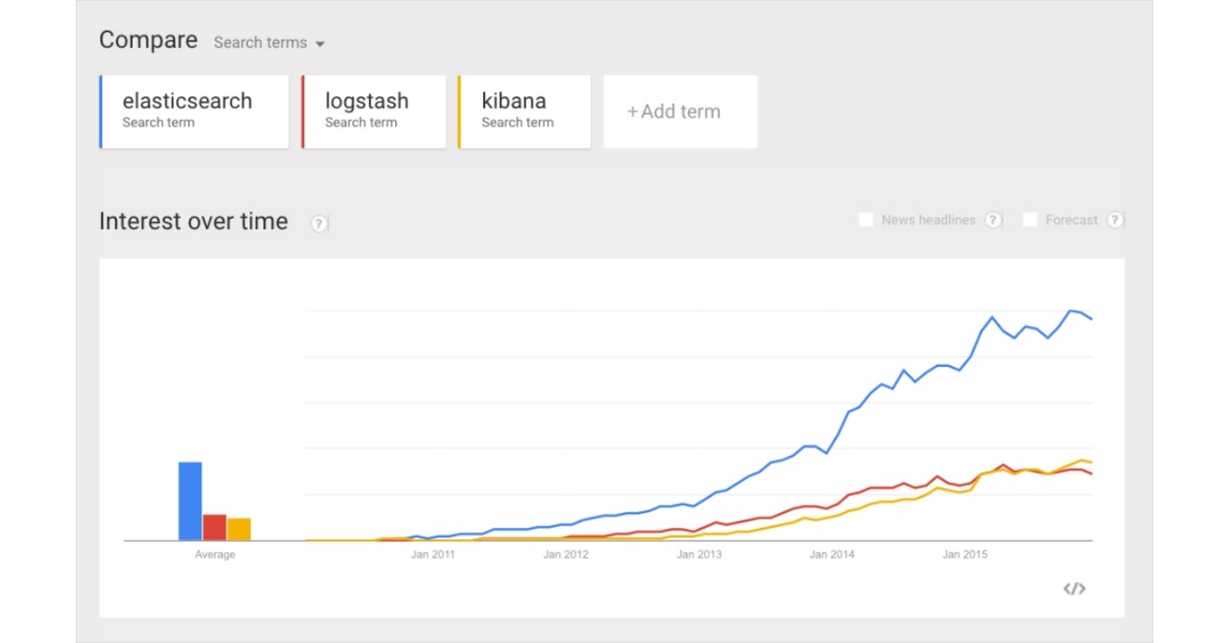
What is ELK So Popular (bigger picture)?
14
Copyright 2013-2016, RX-M LLC
The bigger picture: IT organizations are increasingly favoring open source products in general, and this is why newer proprietary log analysis software platforms such as Sumo Logic, which self-reports only 700 customers, might have a hard time gaining traction today.
After all, how do Netflix, Facebook, Microsoft, LinkedIn, and Cisco monitor their logs? With ELK.

Slide 15
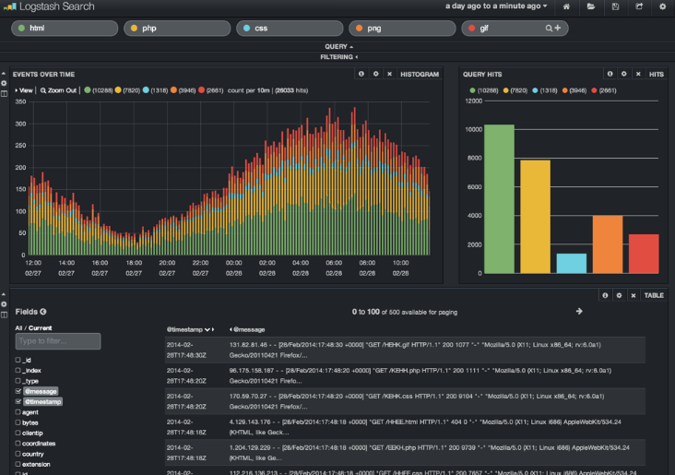
Why do we need a log analysis solution?
15
Copyright 2013-2016, RX-M LLC
As more and more IT infrastructures move to public clouds such as Amazon Web Services and Microsoft Azure, public cloud security tools and log analytics platforms are both becoming more and more critical.
In cloud-based infrastructures, performance isolation is extremely difficult to reach — particularly whenever systems are heavily loaded. The performance of virtual machines in the cloud can greatly fluctuate based on the specific loads, infrastructure servers, environments, and number of active users. As a result, reliability and node failures can become significant problems.
Log management platforms can monitor all of these infrastructure issues as well as process operating system logs, NGINX and IIS server logs for technical SEO and web traffic analysis, application logs, and ELB and S3 logs on AWS.

Slide 16
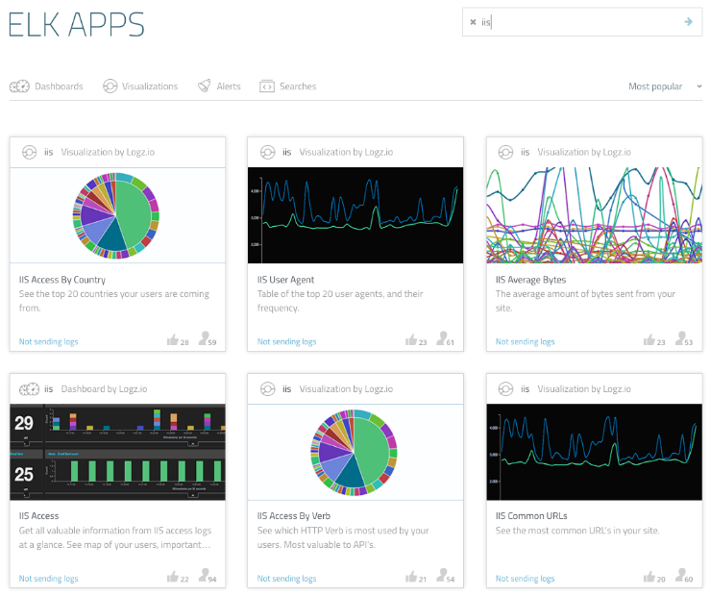
Data Informed Decisions are what ELK enables!
16
Copyright 2013-2016, RX-M LLC
In all of these contexts, DevOps engineers, system administrators, site reliability engineers, and developers can all use logs to make better decisions that are data-informed (and not, as Facebook’s Adam Mosseri says, data-driven). After all, what is being called “big data analytics” is increasingly important for a number of reasons — particularly when it comes to the cloud.
“The future state of Big Data will be a hybrid of on-premises and cloud,” Forrester Research analyst Brian Hopkins told Computer World. Here are just a few examples from that analysis:
Hadoop, a framework for processing extremely large data sets, now works in the cloud and not only on physical machines
Intuit has moved towards cloud analytics because it needs a “secure, stable, and auditable environment”
Cheaper computational power is allowing engineers to create machine-learning algorithms that can perform predictive analytics in the cloud

Slide 17

Elasticsearch
17
Copyright 2013-2016, RX-M LLC
Elasticsearch is often described as a search server. That might be confusing because we usually think of search as something that we do, not something that needs to be served. However, the reality is that search can be quite complex, and search servers have been developed in response to that fact.
Described in more familiar terms, Elasticsearch is a NoSQL database. That means it stores data in an unstructured way and that you cannot use SQL to query it. Unlike most NoSQL databases, though, Elasticsearch has a strong focus on search capabilities and features — so much so, in fact, that the easiest way to get data from Elasticsearch is to search for it using the REST API.

Slide 18
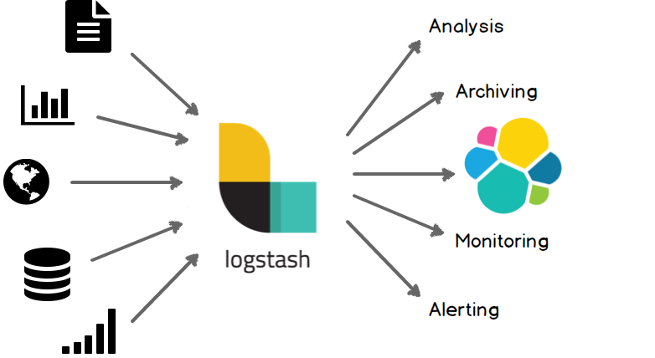

Logstash
18
Copyright 2013-2016, RX-M LLC
A great use for the ELK Stack is the storing, visualization, and analysis of logs and other time-series data. Logstash is an integral part of the data workflow from the source to Elasticsearch and further. Not only does it allow you to pull data from a wide variety of sources, it also gives you the tools to filter, massage, and shape the data so that it’s easier to work with.

Slide 19
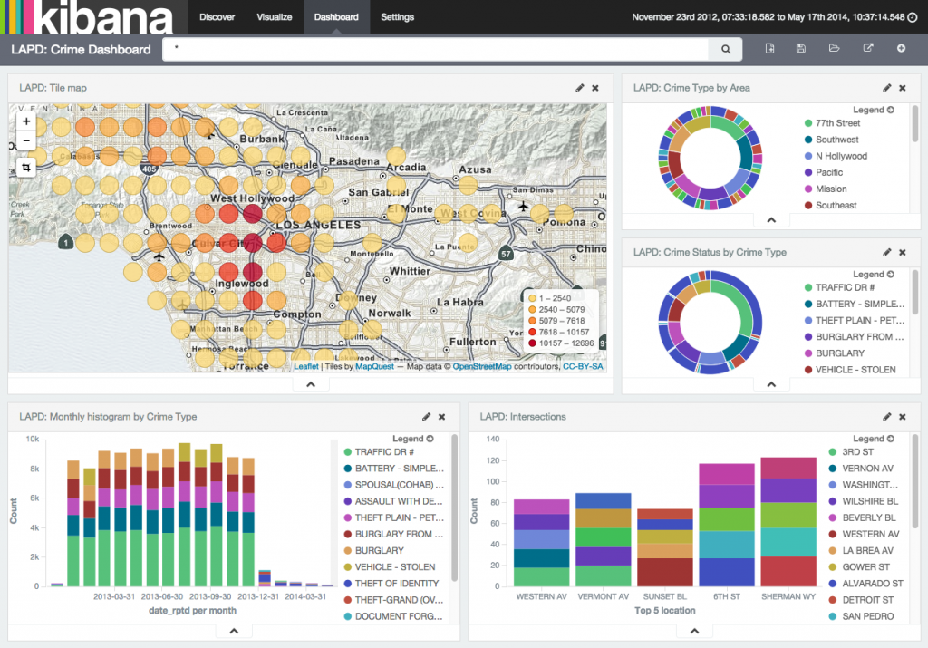
Kibana
Kibana is the visualization layer of the ELK Stack, which is the most popular log analytics platform and is built on top of Elasticsearch, Logstash, and Kibana. This tutorial will cover both the simple and advanced features of Kibana over a few parts. This first part will explain how to run searches in Kibana using the Lucene query syntax.
19

Slide 20
Summary – Module 1 ELK
What is ELK?
Why we need analysis?
Elasticsearch
Logstash
Kibana

Slide 21
Lab #1– Installing ELK
Install Elasticsearch
Install Logstash
Install Kibana

Slide 22

Module 2: Overview of Elasticsearch

Slide 23

Objectives
Features
Installation
Configuration
Operations
Extending
Tools and Tips

Slide 24

What is Elasticsearch?
Elasticsearch is an open-source, broadly-distributable, readily-scalable, enterprise-grade search engine. Accessible through an extensive and elaborate API, Elasticsearch can power extremely fast searches that support your data discovery applications.
Elastic{ON} 2015 conference attendees were asked
^{"What is Elasticsearch?“}

Slide 25

A Short Timeline for Elasticsearch
2004 - Shay Banon created Compass in 2004.^{[2]} While thinking about the third version of Compass he realized that it would be necessary to rewrite big parts of Compass to "create a scalable search solution".^{[2]} So he created "a solution built from the ground up to be distributed" and used a common interface, JSON over HTTP, suitable for programming languages other than Java as well.^{[2]}
2010 - Shay Banon released the first version of Elasticsearch in February 2010.^{[3]}
2012 - Elasticsearch BV was founded in 2012 to provide commercial services and products around Elasticsearch and related software.^{[4]}
2014 - In June 2014, the company announced raising $70 million in a Series C funding round, just 18 months after forming the company. This round brings total funding to $104M.^{[5]}
2015 - In October 2015, Elastic.co released a major release, 2.0, of Elasticsearch which incorporated major changes.

Slide 26
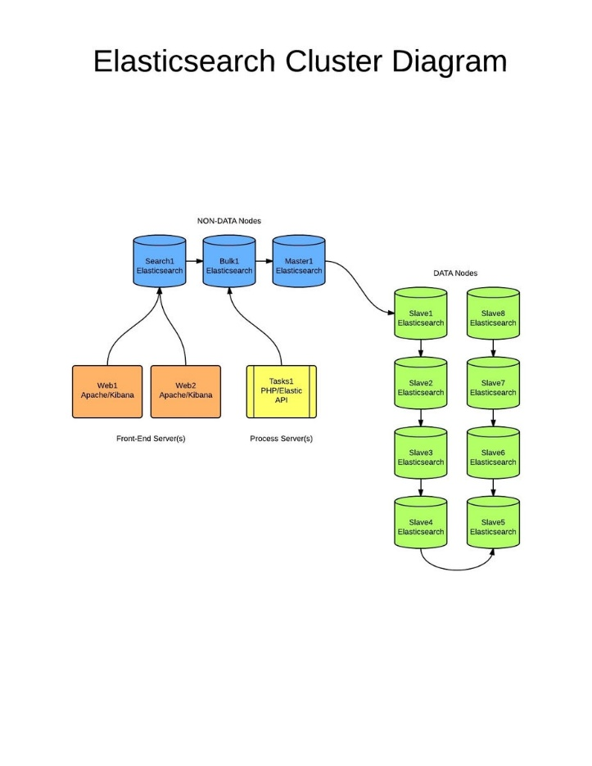
Key Features of Elasticsearch
Elasticsearch is a distributed RESTful search engine built for the cloud. Features include:
Distributed and Highly Available Search Engine.
Each index is fully sharded with a configurable number of shards.
Each shard can have one or more replicas.
Read / Search operations performed on any of the replica shards.
Multi Tenant with Multi Types.
Support for more than one index.
Support for more than one type per index.
Index level configuration (number of shards, index storage, …).
Various set of APIs
HTTP RESTful API
Native Java API.
All APIs perform automatic node operation rerouting.
Document oriented
No need for upfront schema definition.
Schema can be defined per type for customization of the indexing process.
Reliable, Asynchronous Write Behind for long term persistency.
(Near) Real Time Search.
Built on top of Lucene
Each shard is a fully functional Lucene index
All the power of Lucene easily exposed through simple configuration / plugins.
Per operation consistency
Single document level operations are atomic, consistent, isolated and durable.
Open Source under the Apache License, version 2 (“ALv2”)

Slide 27
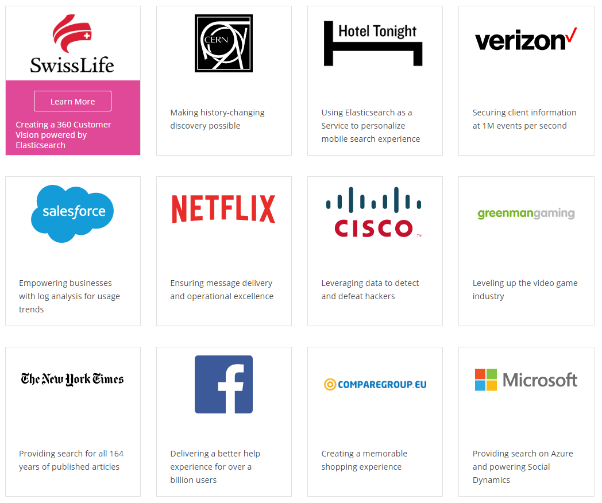
Who uses Elasticsearch?

Slide 28
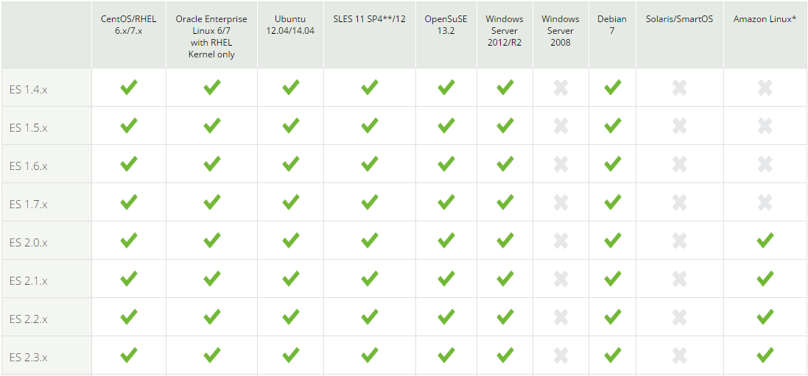
Supported Operating Systems
Note that Windows 2012 only is supported and Amazon Linux requires 2.0.

Slide 29
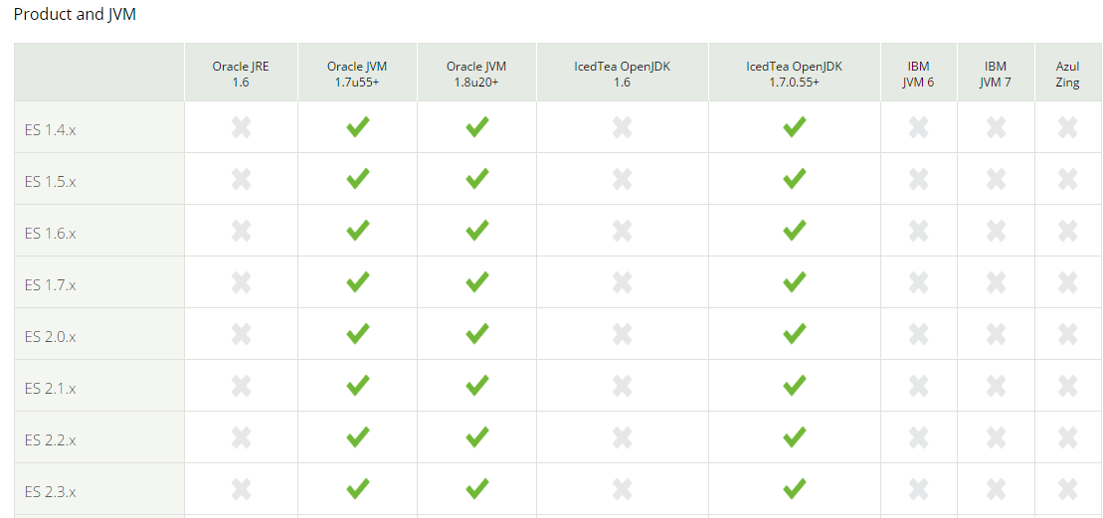
Supported Java Virtual Machines
Any JVM can be used really, but use these if you are running a production, qa environment.

Slide 30
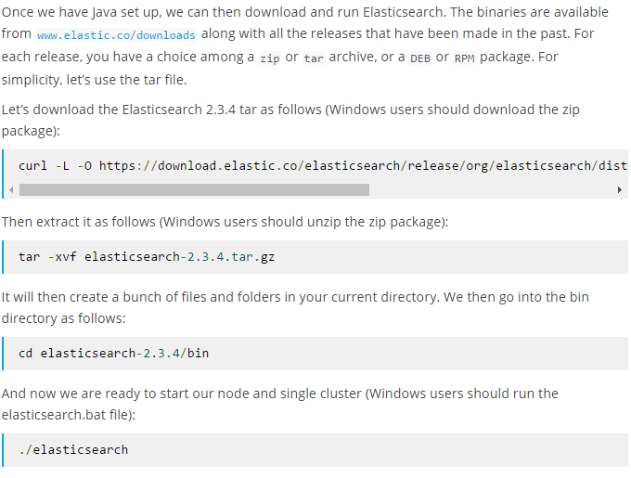
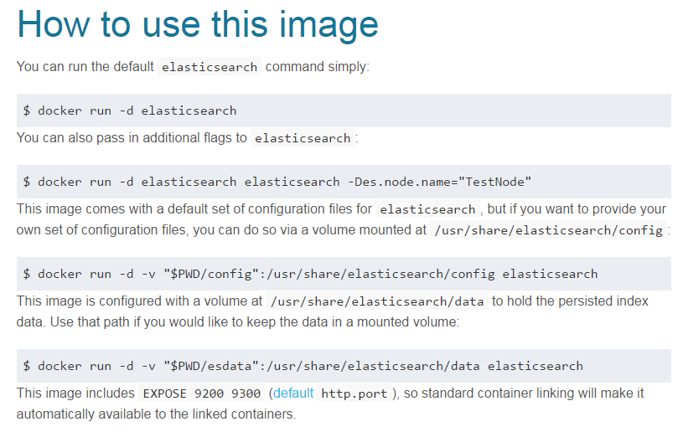
Sources to Obtain Elasticsearch
Elastic.co source download (All that run a JVM)
Elastic.co Yum repository (RHEL and clones)
Elastic.co Apt repository (Ubuntu)
Brew Install (OS X)
Official Docker Repository

Slide 31
How to Install Elasticsearch
The requirements for Elasticsearch are simple: Java 7. Take a look at my Logstash tutorial in this guide to ensure that you are set. Also, make sure that your operating system is on the Elastic support matrix, otherwise you might run up against strange and unpredictable issues. Once that is done, you can start with installing Elasticsearch.
Elasticsearch can be downloaded as a standalone distribution or installed using the apt and yum repositories.

Slide 32
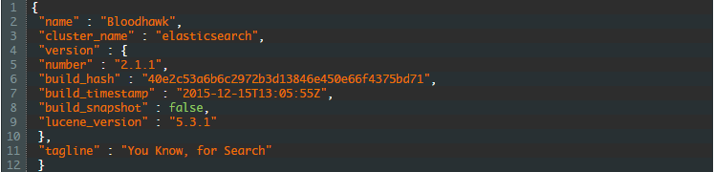
Is it working?
On Linux and other Unix-based systems, you can now run bin/elasticsearch — or on Windows, bin/elasticsearch.bat — to get it up and running. And that’s it! To confirm that everything is working fine, point curl or your browser to http://127.0.0.1:9200, and you should see something like the following output:

Slide 33
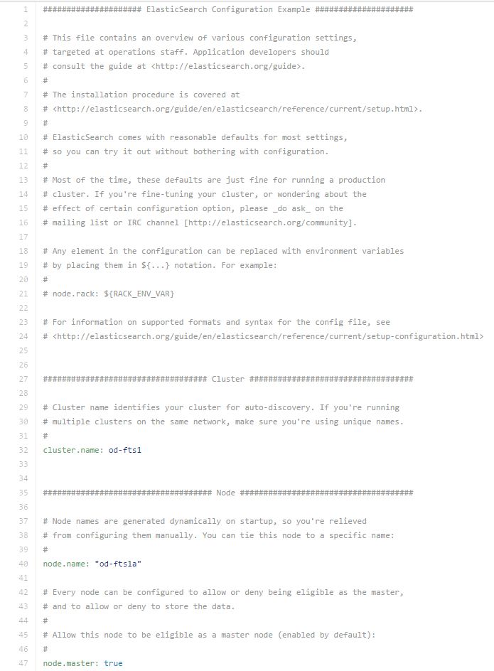
Configuration Files
Found in the “config” directory of your installation (i.e. /etc/elasticsearch, config, etc)
Elasticsearch.yml
Can define node name, cluster name, master nodes, etc
Logging.yml
Logs with Log4j (java) and controls logging level, detail, etc.
Values declared inside these files are permanent versus transient.
Once configuration is set; start up your cluster for management even if it is one node

Slide 34
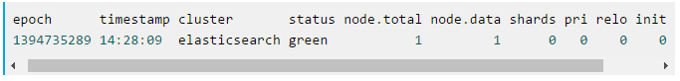
Exploring your Cluster
The REST API
Now that we have our node (and cluster) up and running, the next step is to understand how to communicate with it. Fortunately, Elasticsearch provides a very comprehensive and powerful REST API that you can use to interact with your cluster. Among the few things that can be done with the API are as follows:
Check your cluster, node, and index health, status, and statistics
Administer your cluster, node, and index data and metadata
Perform CRUD (Create, Read, Update, and Delete) and search operations against your indexes
Execute advanced search operations such as paging, sorting, filtering, scripting, aggregations, and many others

Slide 35
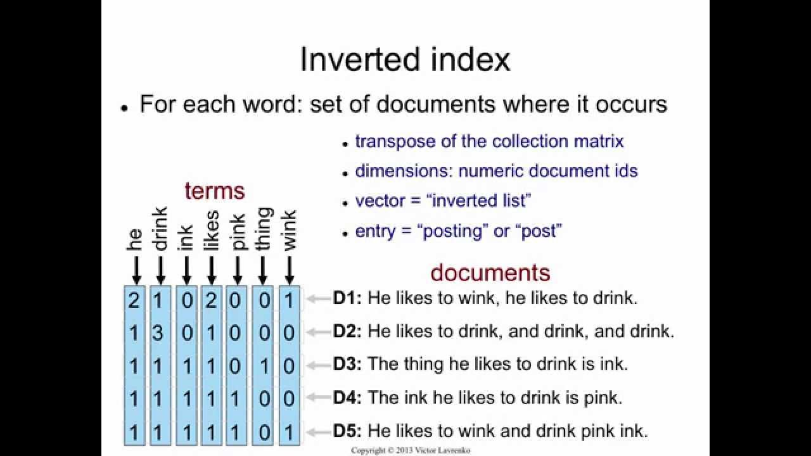
Index and Indices
Index - An index is the logical place where Elasticsearch stores the data. Each index can be spread onto multiple Elasticsearch nodes and is divided into one or more smaller pieces called shards that are physically placed on the hard drives. If you are coming from the relational database world, you can think of an index like a table. However, the index structure is prepared for fast and efficient full text searching and, in particular, does not store original values. That structure is called an inverted index (https://en.wikipedia.org/wiki/Inverted_index).
If you know MongoDB, you can think of the Elasticsearch index as a collection in MongoDB. If you are familiar with CouchDB, you can think about an index as you would about the CouchDB database. Elasticsearch can hold many indices located on one machine or spread them over multiple servers. Every index is built of one or more shards, and each shard can have many replicas.

Slide 36
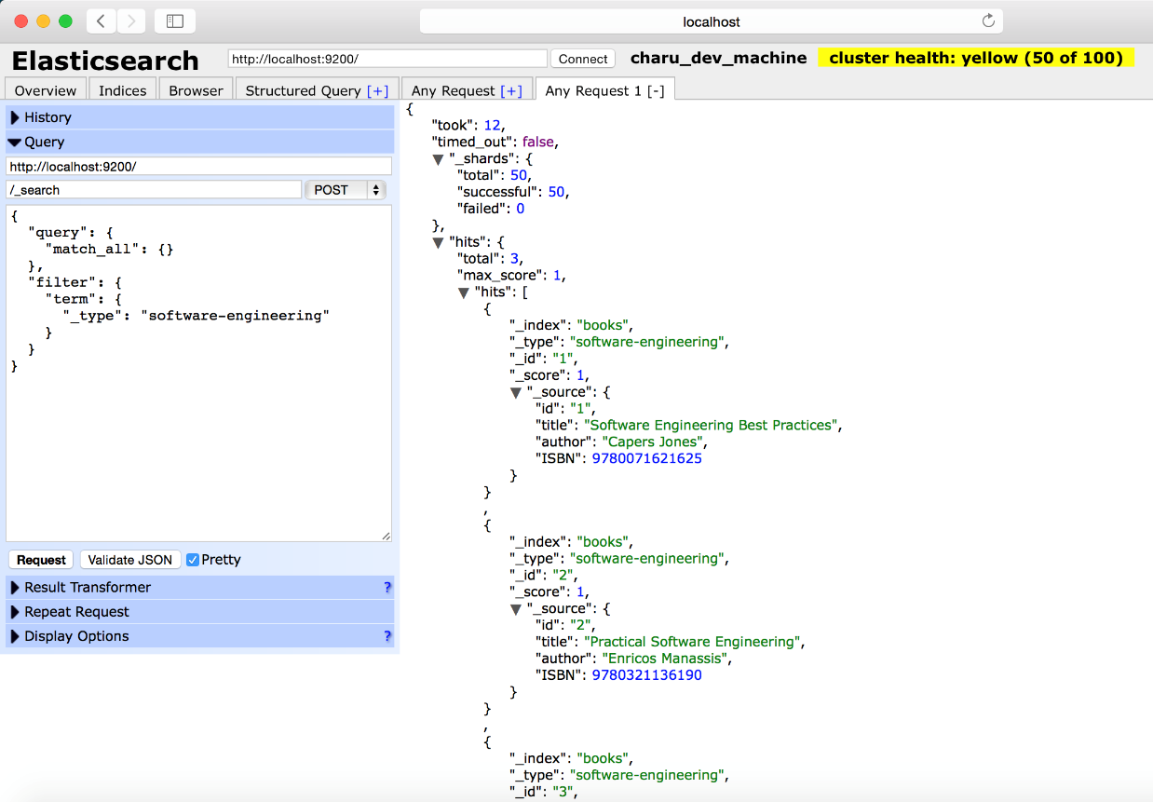
Documents
DOCUMENT - The main entity stored in Elasticsearch is a document. A document can have multiple fields, each having its own type and treated differently. Using the analogy to relational databases, a document is a row of data in a database table. All the documents with a field called title need to have the same data type for it, for example, string.
Documents consist of fields, and each field may occur several times in a single document (such a field is called multivalued). Each field has a type (text, number, date, and so on). The field types can also be complex—a field can contain other subdocuments or arrays. The field type is important to Elasticsearch because type determines how various operations such as analysis or sorting are performed.
Unlike the relational databases, documents don't need to have a fixed structure—every document may have a different set of fields, and in addition to this, fields don't have to be known during application development. Of course, one can force a document structure with the use of schema. From the client's point of view, a document is a JSON object (see more about the JSON format athttps://en.wikipedia.org/wiki/JSON). Each document is stored in one index and has its own unique identifier, which can be generated automatically by Elasticsearch, and document type. The thing to remember is that the document identifier needs to be unique inside an index and should be for a given type. This means that, in a single index, two documents can have the same unique identifier if they are not of the same type.

Slide 37
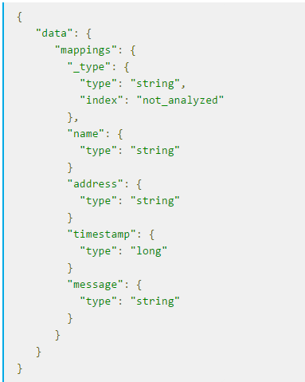
Document Types
DOCUMENT TYPE - In Elasticsearch, one index can store many objects serving different purposes. For example, a blog application can store articles and comments. The document type lets us easily differentiate between the objects in a single index. Every document can have a different structure, but in real-world deployments, dividing documents into types significantly helps in data manipulation. Of course, one needs to keep the limitations in mind. That is, different document types can't set different types for the same property. For example, a field called title must have the same type across all document types in a given index.

Slide 38
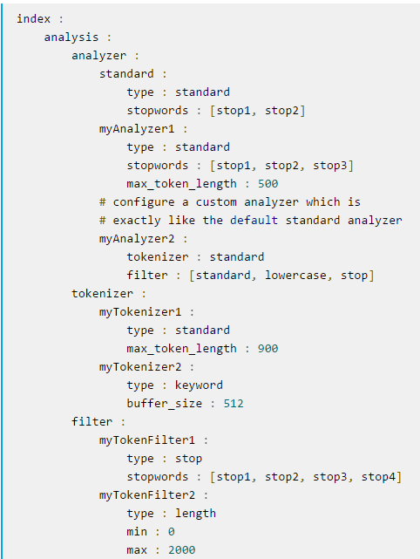
Analysis
Analysis is the process of converting full text to terms. Depending on which analyzer is used, these phrases: FOO BAR, Foo-Bar, foo,bar will probably all result in the terms foo and bar. These terms are what is actually stored in the index. A full text query (not a term query) for FoO:bAR will also be analyzed to the terms foo,bar and will thus match the terms stored in the index. It is this process of analysis (both at index time and at search time) that allows elasticsearch to perform full text queries. Also see text and term.

Slide 39
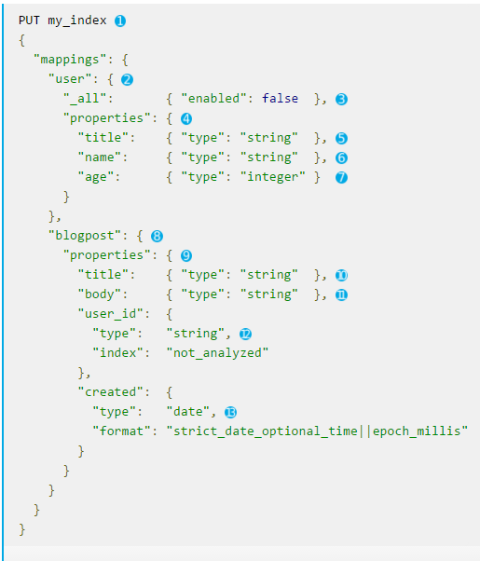
Mappings
Mapping - Every field of the document must be properly analyzed depending on its type. For example, a different analysis chain is required for the numeric fields (numbers shouldn't be sorted alphabetically) and for the text fetched from web pages (for example, the first step would require you to omit the HTML tags as it is useless information). To be able to properly analyze at indexing and querying time, Elasticsearch stores the information about the fields of the documents in so-called mappings. Every document type has its own mapping, even if we don't explicitly define it.

Slide 40
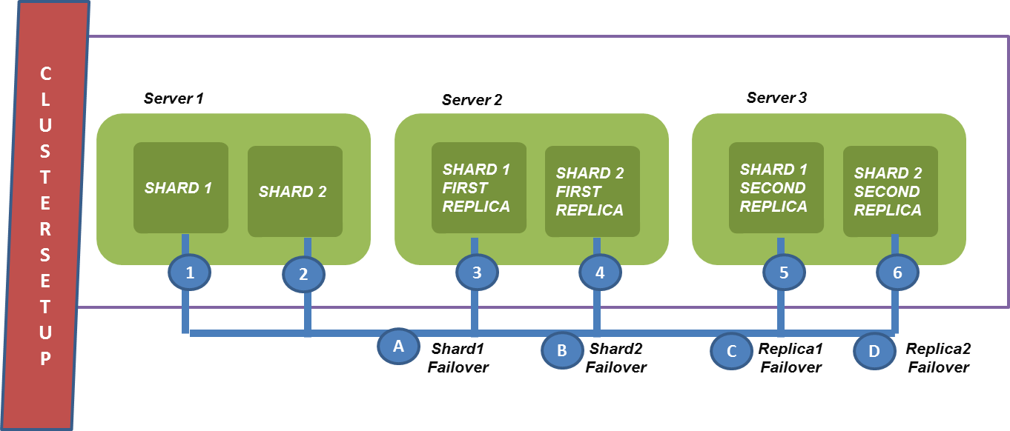
Nodes and Clusters
Nodes and clusters- Elasticsearch can work as a standalone, single-search server. Nevertheless, to be able to process large sets of data and to achieve fault tolerance and high availability, Elasticsearch can be run on many cooperating servers. Collectively, these servers connected together are called a cluster and each server forming a cluster is called a node.

Slide 41
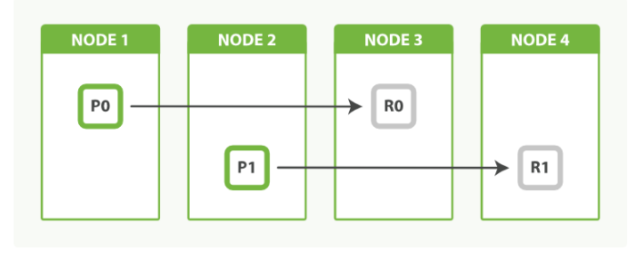
Primary Shards
Each document is stored in a single primary shard. When you index a document, it is indexed first on the primary shard, then on all replicas of the primary shard. By default, an index has 5 primary shards. You can specify fewer or more primary shards to scale the number of documents that your index can handle. You cannot change the number of primary shards in an index, once the index is created. See also routing

Slide 42
Replica Shards
Each primary shard can have zero or more replicas. A replica is a copy of the primary shard, and has two purposes:
increase failover: a replica shard can be promoted to a primary shard if the primary fails
increase performance: get and search requests can be handled by primary or replica shards. By default, each primary shard has one replica, but the number of replicas can be changed dynamically on an existing index. A replica shard will never be started on the same node as its primary shard.

Slide 43
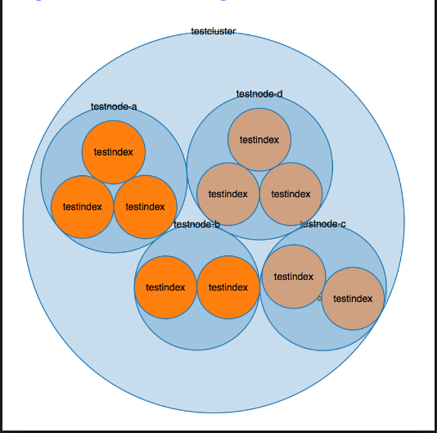
Clustering – Overview
A cluster consists of one or more nodes which share the same cluster name. The cluster acts as a team with the purpose of managing, accepting, and providing ES data. Each cluster is comprised of separate servers (virtual or physical) and has a single master node which is chosen automatically by the cluster and which can be replaced if the current master node fails.

Slide 44
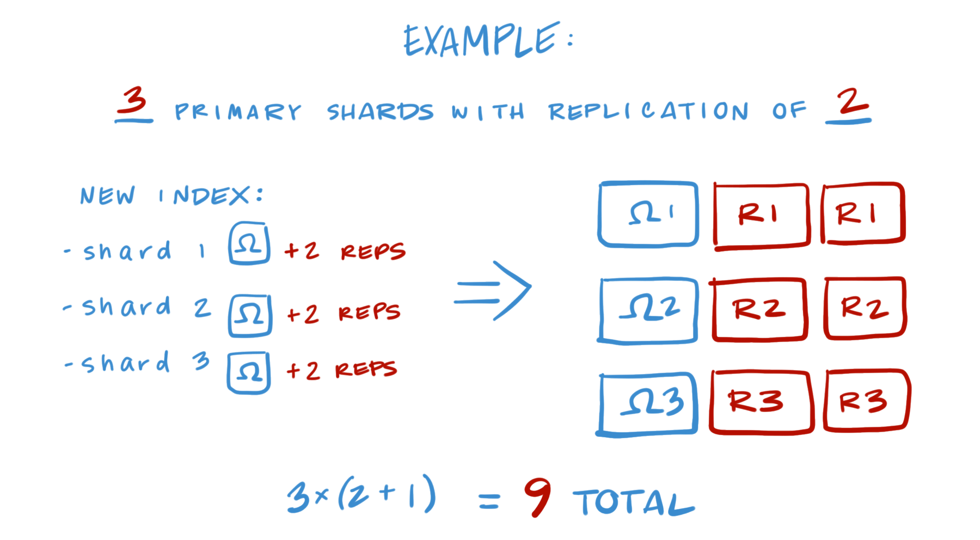
Shard Allocation
Note again that every shard contains a set of data from an index.
Read Replicas are set copies of primary shards that are read-only.
Read Replicas can be promoted to primary if a primary fails.

Slide 45
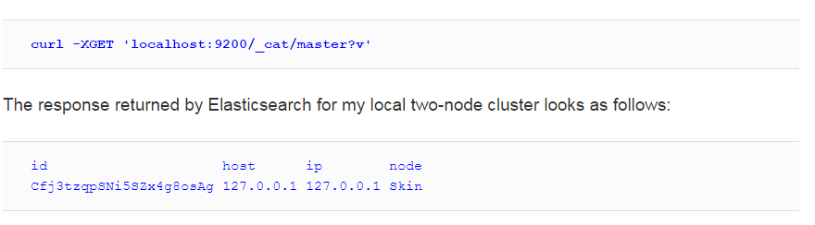
Node Roles
Node roles - Elasticsearch nodes can be configured to work in one of the following roles:
Master: The node responsible for maintaining the global cluster state, changing it depending on the needs, and handling the addition and removal of nodes. There can only be a single master node active in a single cluster.
Data: The node responsible for holding the data and executing data related operations (indexation and searching) on the shards that are present locally for the node.
Client: The node responsible for handling requests. For the indexing requests, the client nodeforwards the request to the appropriate primary shard and, for the search requests, it sends it to all the relevant shards and aggregates the results.

Slide 46
Indexing
However, until now we've used Elasticsearch functionality that allows us not to care about indices, shards, and data structure. This is not something that you may be used to when you are coming from the world of SQL databases, where you need the database and the tables with all the columns created upfront. In general, you needed to describe the data structure to be able to put data into the database. Elasticsearch is schema-less (data-driven schema) and by default creates indices automatically and because of that we can just install it and index data without the need of any preparations.

Slide 47
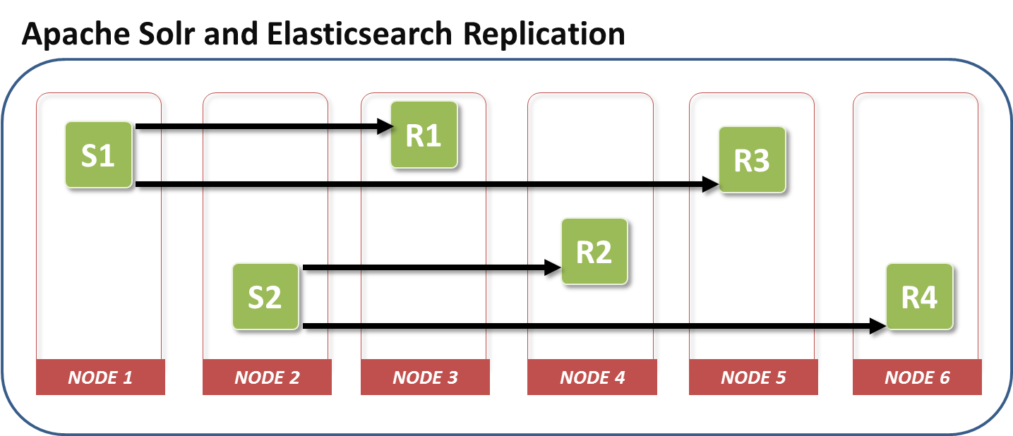
Key Points about Indexing
Having more shards in the index allows us to spread the index between more servers and parallelize the indexing operations and thus have better indexing throughput.
Depending on your deployment, having more shards may increase query throughput and lower queries latency – especially in environments that don't have a large number of queries per second.
Having more shards may be slower compared to a single shard query, because Elasticsearch needs to retrieve the data from multiple servers and combine them together in memory, before returning the final query results.
Having more replicas results in a more resilient cluster, because when the primary shard is not available, its copy will take that role. Basically, having a single replica allows us to lose one copy of a shard and still serve the whole data. Having two replicas allows us to lose two copies of the shard and still see the whole data.
The higher the replica count, the higher queries throughput the cluster will have. That's because each replica can serve the data it has independently from all the others.
The higher number of shards (both primary and replicas) will result in more memory needed by Elasticsearch.

Slide 48
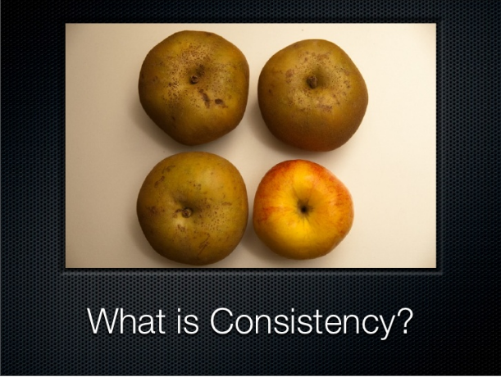
Write Consistency
Elasticsearch allows us to control the write consistency to prevent writes happening when they should not. By default, Elasticsearch indexing operation is successful when the write is successful on the quorum on active shards – meaning 50% of the active shards plus one.
We can control this behavior by adding action.write_consitency to our elasticsearch.yml file or by adding the consistency parameter to our index request. The mentioned properties can take the following values:
quorum: The default value, requiring 50% plus 1 active shards to be successful for the index operation to succeed
one: Requires only a single active shard to be successful for the index operation to succeed
all: Requires all the active shards to be successful for the index operation to succeed

Slide 49
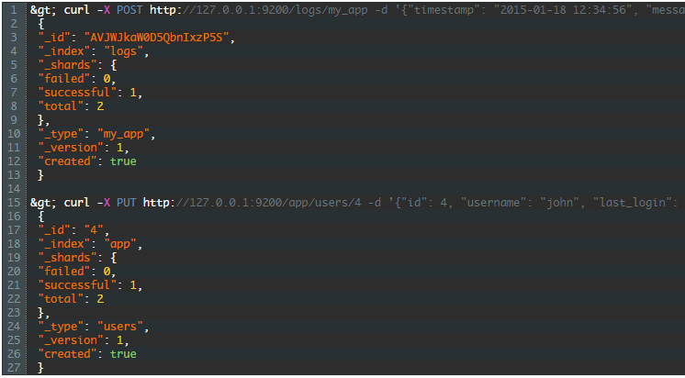
Creating an Index in Elasticsearch
Adding data to Elasticsearch is called “indexing.” This is because when you feed data into Elasticsearch, the data is placed into Apache Lucene indexes. This makes sense because Elasticsearch uses the Lucene indexes to store and retrieve its data. Although you do not need to know a lot about Lucene, it does help to know how it works when you start getting serious with Elasticsearch.
Elasticsearch behaves like a REST API, so you can use either the POST or the PUT method to add data to it. You use PUT when you know the or want to specify the ID of the data item, or POST if you want Elasticsearch to generate an ID for the data item:

Slide 50
Creating an Index in Elasticsearch
The data for the document is sent as a JSON object. You might be wondering how we can index data without defining the structure of the data. Well, with Elasticsearch, like with most other NoSQL databases, there is no need to define the structure of the data beforehand. To ensure optimal performance, though, you can define mappings for data types. More on this later.
If you are not comfortable with curl, look into the unofficial Sense Chrome plugin or the Sense Kibana app. You can also use log shippers like Beats and data pipelines like Logstash to automate the data-ingress process.

Slide 51
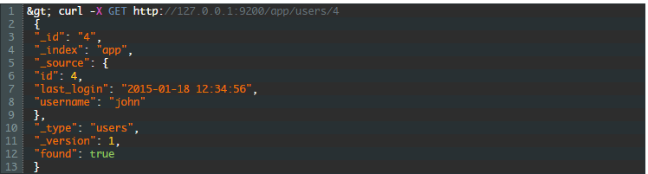
Elasticsearch Query: Getting Information Out
Once you have your data indexed into Elasticsearch, you can start searching and analyzing it. The simplest query you can do is to fetch a single item. Once again, because Elasticsearch is a REST API, we use GET:
The fields starting with an underscore are all meta fields of the result. The _source object is the original document that was indexed.

Slide 52
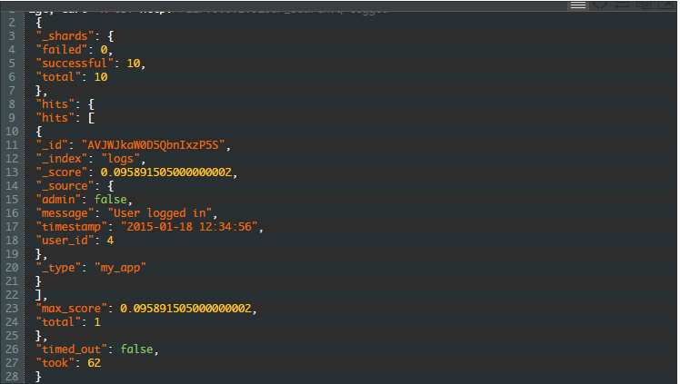
Elasticsearch Query: Getting Information Out
We also use GET to do searches by calling the _search endpoint:
The result contains a number of extra fields that describe both the search and the result. Here’s a quick rundown:
took: The time in milliseconds the search took
timed_out: If the search timed out
shards: The number of Lucene shards searched, and their success and failure rates
hits: The actual results, along with meta information for the results

Slide 53
URI Search
The search we did above is known as a URI Search, and is the simplest way to query Elasticsearch. By providing only a word, all of the fields of all the documents are searched for that word. You can build more specific searches by using Lucene queries:
username:johnb – Looks for documents where the username field is equal to “johnb”
john* – Looks for documents that contain terms that start with john and is followed by zero or more characters such as “john,” “johnb,” and “johnson”
john? – Looks for documents that contain terms that start with john followed by only one character. Matches “johnb” and “johns” but not “john.”
There are many other ways to search including the use of boolean logic, the boosting of terms, the use of fuzzy and proximity searches, and the use of regular expressions.
What is even more awesome is that URI searches are just the beginning. Elasticsearch also provides a request body search with a Query DSL for more advanced searches. There is a wide array of options available in these kinds of searches, and you can mix and match different options to get the results that you require. Some of the options include geo queries, “more like this” queries, and scripted queries.

Slide 54
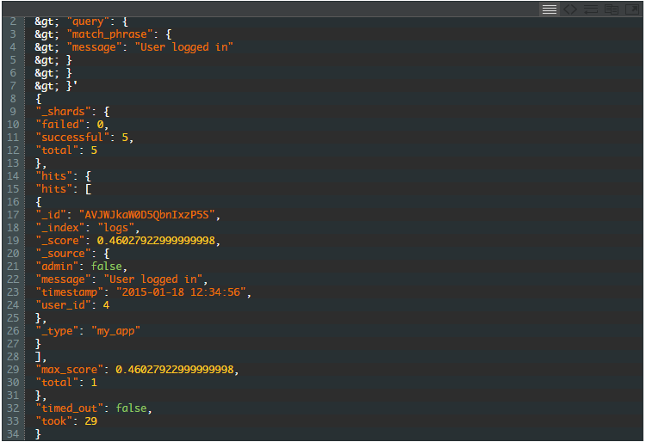
More URI Search
The DSL also makes a distinction between a filtering and a query context for query clauses. Clauses used as filters test documents in a boolean fashion: Does the document match the filter, “yes” or “no”? Filters are also generally faster than queries, but queries, can also calculates a score based on how closely a document matches the query. This is used to determine the ordering and inclusion of documents:

Slide 55
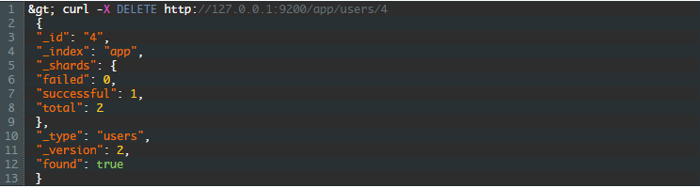
Removing Elasticsearch Data
Deleting items from Elasticsearch is just as easy as entering data into Elasticsearch. The HTTP method to use this time is — surprise, surprise! — DELETE:

Slide 56
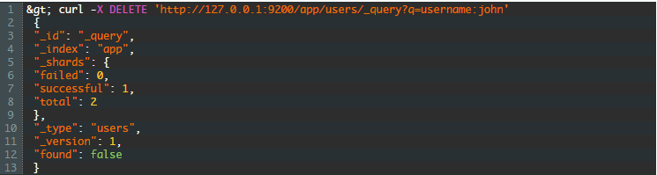
Removing Elasticsearch Data
Deleting items from Elasticsearch is just as easy as entering data into Elasticsearch. The HTTP method to use this time is — surprise, surprise! — DELETE:
As with retrieving data, you don’t need to know the ID of the item you’re deleting. You can delete items by specifying a query:

Slide 57
Elasticsearch plugins: Managing with KOPF
KOPF is a plugin that allows users to get a visual look at your elasticsearch cluser.
It is installed as follows:
bin/plugin --install lmenezes/elasticsearch-kopf/1.1
And now you can navigate to http://localhost:9200/_plugin/kopf/ and access your elasticssearch cluster visually.
Take a look at the following tabs:
REST: Similar to SENSE- you can enter queries here and they will be executed
Aliases: Use these to manage index aliases
Analysis: Test and show the analyzers for different values
Percolator: You can register new percolator queries here and view existing queries. You can’t do actual percolation here.
Warmers: Use this tab to register index warmer queries.
Repository: Create repositories and snapshots for the snapshot and restore feature in Elasticsearch

Slide 58
Summary – Module 2: Elasticsearch
Elasticsearch is an open-source, broadly-distributable, readily-scalable, enterprise-grade search engine
Managed through an HTTP RESTful API
Schema less with a data driven schema
Written in Java and backed by Apache Lucene
Used by many major tech players in the market
Near Real Time Search
Runs supported on Windows and Linux in production, but on anything that runs in a JVM.
Index, documents, fields, and mappings make up core data components of ElasticSearch
The roles of ES servers are either data, master, or client nodes. (Tribe also)
Clusters are collections of nodes
Shards are data segments dedicated to one or more nodes.
Indexing is a way of grouping key terms to enable search

Slide 59
Lab #2: Elasticsearch
Create, Update, Retrieve, and delete with elasticsearch
Search parameters
Pushing files in and out of elasticsearch

Slide 60

Module 3: Logstash

Slide 61
Objectives
Installation
Configuration
Plugins
Lots of Examples

Slide 62
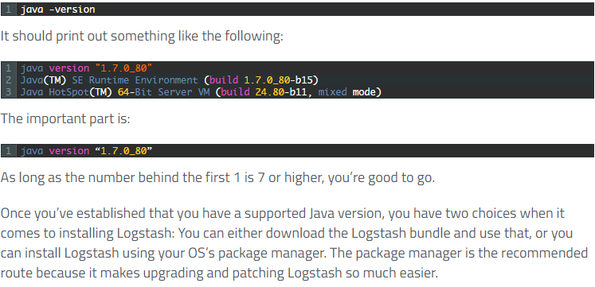
Installing Logstash
The only requirement for installing Logstash is Java 7 or higher. Everything else you need, including JRuby, the language Logstash was written in, is included in the Logstash bundle. The easiest way to confirm if you have the correct version of Java installed is to run the following in your CLI:

Slide 63
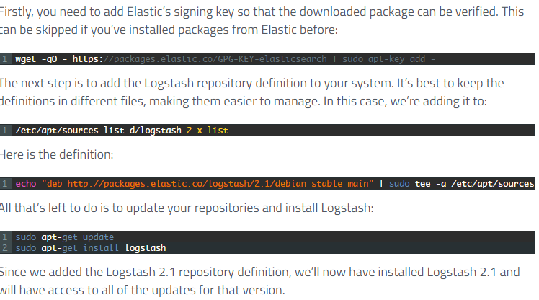
Installing Logstash – Package Manager

Slide 64
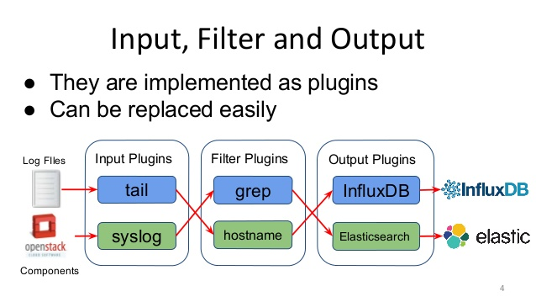
Configuring Logstash – Logstash Inputs
One of the things that makes Logstash great is its ability to source logs and events from various sources. As of version 2.1, there are 48 different inputs on the Logstash documentation page. That’s 48 different technologies, locations, and services from where you can pull events and manipulate them. These include monitoring systems like collectd, databases like Redis, services like Twitter, and various others such as File and RabbitMQ. By using these inputs, you can import data from multiple sources and manipulate them however you want — and eventually send them to other systems for storage or processing.
Inputs are the starting point of any configuration. If you do not define an input, Logstash will automatically create a stdin input. Since you can create multiple inputs, it’s important to type and tag them so that you can properly manipulate them in filters and outputs.

Slide 65
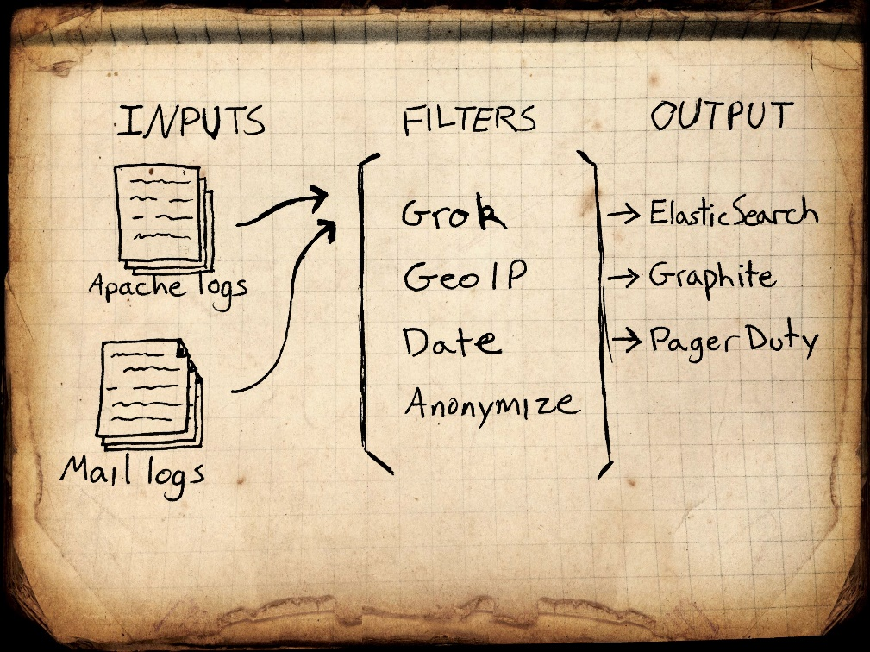
Configuring Logstash – Logstash Filters
If Logstash were just a dumb pipe between a number of inputs and outputs, you could easily replace it with a service like IFTTT or Zapier. Luckily, it isn’t. It also comes with a number of very powerful filters with which you can manipulate, measure, and create events. It’s the power of these filters that makes Logstash a very versatile and valuable tool.
Logstash events can come from multiple sources, so as with outputs, it’s important to do checks on whether or not an event should be processed by a particular filter.

Slide 66
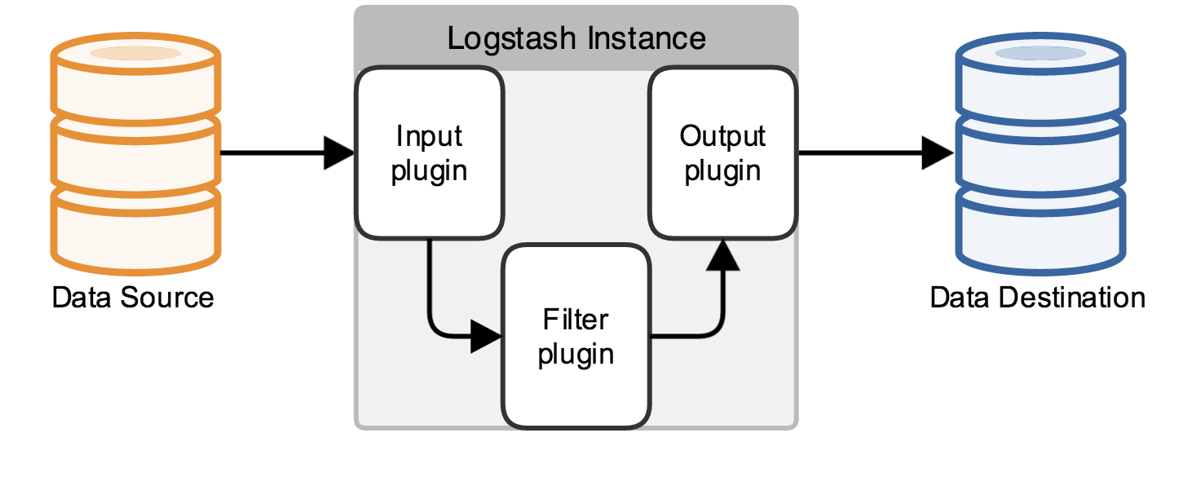
Configuring Logstash – Logstash Outputs
As with the inputs, Logstash comes with a number of outputs that enable you to push your events to various locations, services, and technologies. You can store events using outputs such as File, CSV, and S3, convert them into messages with RabbitMQ and SQS, or send them to various services like HipChat, PagerDuty, or IRC. The number of combinations of inputs and outputs in Logstash makes it a really versatile event transformer.
Logstash events can come from multiple sources, so as with filters, it’s important to do checks on whether or not an event should be processed by a particular output. If you define no output, Logstash will automatically create a stdout output.

Slide 67
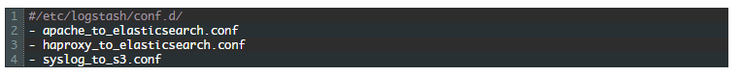
A Configuration Example
Your configurations will generally have three sections: inputs, outputs and filters. You can have multiple instances of each of these instances, which means that you can group related plugins together in a config file instead of grouping them by type. My Logstash configs are generally structured as follows:

Slide 68
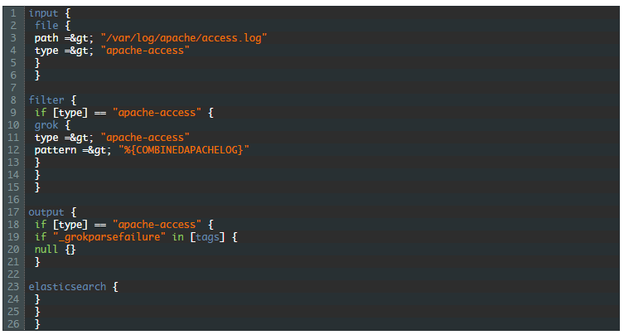
A Configuration Example
You’ll see that I have a configuration file for each of the functions or integrations that I’d like Logstash to perform. Each of those files will contain the necessary inputs, filters, and outputs to perform that function. Let’s look at the apache_to_elasticsearch.conf file, as it’s typical of what you’d see in a Logstash config file:
Notes:
The input section tells Logstash to pull logs from the Apache access log and specify the type of those events as apache-access. Setting the type is important, as it will be used to selectively apply filters and outputs later on in the event’s lifetime. It’s also used to organize the events when it’s eventually pushed to Elasticsearch.
In the filter section, we specifically apply a grok filter to events that have the apache-access type. This conditional ensures that only the apache-access events get filtered. If it is not there, Logstash will attempt to apply the grok filter to events from other inputs as well. This filter parses the log string and populates the event with the relevant information from the Apache logs.
Lastly, we see the output section. The first conditional ensures, once again, that we only operate on the apache-access events. The next, nested, conditional sends all of the events that didn’t match our grok pattern to the null output. Since they didn’t conform to the specified pattern, we assume that they are log lines that contain information we’re not interested in and discard it. Since order is important in filters and outputs, this will ensure that only events that were successfully parsed will make it to the Elasticsearch output.
Each of the configuration files can contain these three sections. Logstash will typically combine all of our configuration files and consider it as one large config. Since you can have multiple inputs, it’s recommended that you tag your events or assign types to them so that it’s easy to identify them at a later stage. Also ensure that you wrap your filters and outputs that are specific to a category or type of event in a conditional, otherwise you might get some surprising results.

Slide 69
Logstash Plugins
Often used as part of the ELK Stack, Logstash version 2.1.0 now has shutdown improvements and the ability to install plugins offline. Here are just a few of the reasons why Logstash is so popular:
Logstash is able to do complex parsing with a processing pipeline that consists of three stages: inputs, filters, and outputs
Each stage in the pipeline has a pluggable architecture that uses a configuration file that can specify what plugins should be used at each stage, in which order, and with what settings
Users can reference event fields in a configuration and use conditionals to process events when they meet certain, desired criteria
Since it is open source, you can change it, build it, and run it in your own environment
Notes:
The input section tells Logstash to pull logs from the Apache access log and specify the type of those events as apache-access. Setting the type is important, as it will be used to selectively apply filters and outputs later on in the event’s lifetime. It’s also used to organize the events when it’s eventually pushed to Elasticsearch.
In the filter section, we specifically apply a grok filter to events that have the apache-access type. This conditional ensures that only the apache-access events get filtered. If it is not there, Logstash will attempt to apply the grok filter to events from other inputs as well. This filter parses the log string and populates the event with the relevant information from the Apache logs.
Lastly, we see the output section. The first conditional ensures, once again, that we only operate on the apache-access events. The next, nested, conditional sends all of the events that didn’t match our grok pattern to the null output. Since they didn’t conform to the specified pattern, we assume that they are log lines that contain information we’re not interested in and discard it. Since order is important in filters and outputs, this will ensure that only events that were successfully parsed will make it to the Elasticsearch output.
Each of the configuration files can contain these three sections. Logstash will typically combine all of our configuration files and consider it as one large config. Since you can have multiple inputs, it’s recommended that you tag your events or assign types to them so that it’s easy to identify them at a later stage. Also ensure that you wrap your filters and outputs that are specific to a category or type of event in a conditional, otherwise you might get some surprising results.

Slide 70
Logstash Plugins – Some Example Input Plugins
Logstash Input Plugins
Input plugins get events into Logstash and share common configuration options such as:
ype — filters events down the pipeline
tags — adds any number of arbitrary tags to your event
codec — the name of Logstash codec used to represent the data
File Plugin
This plugin streams events from a file by tracking changes to the monitored files and pulling the new content as it’s appended, and it keeps track of the current position in each file by recording it. The input also detects and handles file rotation.
You can configure numerous items including plugin path, codec, read start position, and line delimiter. Usually, the more plugins you use, the more resource that Logstash may consume.
Notes:
The input section tells Logstash to pull logs from the Apache access log and specify the type of those events as apache-access. Setting the type is important, as it will be used to selectively apply filters and outputs later on in the event’s lifetime. It’s also used to organize the events when it’s eventually pushed to Elasticsearch.
In the filter section, we specifically apply a grok filter to events that have the apache-access type. This conditional ensures that only the apache-access events get filtered. If it is not there, Logstash will attempt to apply the grok filter to events from other inputs as well. This filter parses the log string and populates the event with the relevant information from the Apache logs.
Lastly, we see the output section. The first conditional ensures, once again, that we only operate on the apache-access events. The next, nested, conditional sends all of the events that didn’t match our grok pattern to the null output. Since they didn’t conform to the specified pattern, we assume that they are log lines that contain information we’re not interested in and discard it. Since order is important in filters and outputs, this will ensure that only events that were successfully parsed will make it to the Elasticsearch output.
Each of the configuration files can contain these three sections. Logstash will typically combine all of our configuration files and consider it as one large config. Since you can have multiple inputs, it’s recommended that you tag your events or assign types to them so that it’s easy to identify them at a later stage. Also ensure that you wrap your filters and outputs that are specific to a category or type of event in a conditional, otherwise you might get some surprising results.

Slide 71
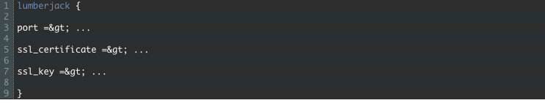
Logstash Plugins – Some Example Input Plugins
Lumberjack
This plugin receives events using the Lumberjack Protocol, which is secure while having low latency, low resource usage, and a reliable protocol. It uses a logstash-forwarder client as its data source, so it is very fast and much lighter than logstash. All events are encrypted because the plugin input and forwarder client use a SSL certificate that needs to be defined in the plugin.
Here are the required configuration:
Notes:
The input section tells Logstash to pull logs from the Apache access log and specify the type of those events as apache-access. Setting the type is important, as it will be used to selectively apply filters and outputs later on in the event’s lifetime. It’s also used to organize the events when it’s eventually pushed to Elasticsearch.
In the filter section, we specifically apply a grok filter to events that have the apache-access type. This conditional ensures that only the apache-access events get filtered. If it is not there, Logstash will attempt to apply the grok filter to events from other inputs as well. This filter parses the log string and populates the event with the relevant information from the Apache logs.
Lastly, we see the output section. The first conditional ensures, once again, that we only operate on the apache-access events. The next, nested, conditional sends all of the events that didn’t match our grok pattern to the null output. Since they didn’t conform to the specified pattern, we assume that they are log lines that contain information we’re not interested in and discard it. Since order is important in filters and outputs, this will ensure that only events that were successfully parsed will make it to the Elasticsearch output.
Each of the configuration files can contain these three sections. Logstash will typically combine all of our configuration files and consider it as one large config. Since you can have multiple inputs, it’s recommended that you tag your events or assign types to them so that it’s easy to identify them at a later stage. Also ensure that you wrap your filters and outputs that are specific to a category or type of event in a conditional, otherwise you might get some surprising results.

Slide 72
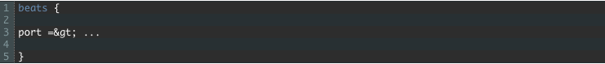
Logstash Plugins – Some Example Input Plugins
Beats
Filebeat is a lightweight, resource-friendly tool that is written in Go and collects logs from files on servers and forwards them to other machines for processing.The tool uses the Beats protocol to communicate with a centralized Logstash instance. You can also using an optional SSL certificate to send events to Logstash securely.
The required configuration:
Notes:
The input section tells Logstash to pull logs from the Apache access log and specify the type of those events as apache-access. Setting the type is important, as it will be used to selectively apply filters and outputs later on in the event’s lifetime. It’s also used to organize the events when it’s eventually pushed to Elasticsearch.
In the filter section, we specifically apply a grok filter to events that have the apache-access type. This conditional ensures that only the apache-access events get filtered. If it is not there, Logstash will attempt to apply the grok filter to events from other inputs as well. This filter parses the log string and populates the event with the relevant information from the Apache logs.
Lastly, we see the output section. The first conditional ensures, once again, that we only operate on the apache-access events. The next, nested, conditional sends all of the events that didn’t match our grok pattern to the null output. Since they didn’t conform to the specified pattern, we assume that they are log lines that contain information we’re not interested in and discard it. Since order is important in filters and outputs, this will ensure that only events that were successfully parsed will make it to the Elasticsearch output.
Each of the configuration files can contain these three sections. Logstash will typically combine all of our configuration files and consider it as one large config. Since you can have multiple inputs, it’s recommended that you tag your events or assign types to them so that it’s easy to identify them at a later stage. Also ensure that you wrap your filters and outputs that are specific to a category or type of event in a conditional, otherwise you might get some surprising results.

Slide 73
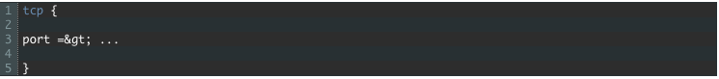
Logstash Plugins – Some Example Input Plugins
TCP
This plugin reads events over a TCP socket. Each event is assumed to be one line of text. The optional SSL certificate is also available. In the codec, the default value is “line.”
The required configuration:
Notes:
The input section tells Logstash to pull logs from the Apache access log and specify the type of those events as apache-access. Setting the type is important, as it will be used to selectively apply filters and outputs later on in the event’s lifetime. It’s also used to organize the events when it’s eventually pushed to Elasticsearch.
In the filter section, we specifically apply a grok filter to events that have the apache-access type. This conditional ensures that only the apache-access events get filtered. If it is not there, Logstash will attempt to apply the grok filter to events from other inputs as well. This filter parses the log string and populates the event with the relevant information from the Apache logs.
Lastly, we see the output section. The first conditional ensures, once again, that we only operate on the apache-access events. The next, nested, conditional sends all of the events that didn’t match our grok pattern to the null output. Since they didn’t conform to the specified pattern, we assume that they are log lines that contain information we’re not interested in and discard it. Since order is important in filters and outputs, this will ensure that only events that were successfully parsed will make it to the Elasticsearch output.
Each of the configuration files can contain these three sections. Logstash will typically combine all of our configuration files and consider it as one large config. Since you can have multiple inputs, it’s recommended that you tag your events or assign types to them so that it’s easy to identify them at a later stage. Also ensure that you wrap your filters and outputs that are specific to a category or type of event in a conditional, otherwise you might get some surprising results.

Slide 74
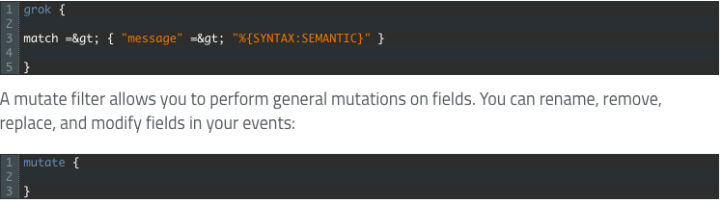
Logstash Plugins – Some Example Filter Plugins
Grok
This plugin is the “bread and butter” of Logstash filters and is used ubiquitously to derive structure out of unstructured data. It helps you to define a search and extract parts of your log line into a structured fields. Roughly 120 integrated patterns are available.
Grok works by combining text patterns into something that matches your logs. The plugin sits on top of regular expressions, so any regular expressions are valid in grok. You can define your own custom patterns in this manner:

Slide 75
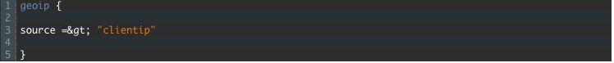
Logstash Plugins – Some Example Filter Plugins
GEOIP
This plugin looks up IP addresses, derives geographic location information from the addresses, and adds that location information to logs.
The configuration options:
Source — The field containing the IP address, this is a required setting
Target — By defining a target in the geoip configuration option, You can specify the field into which Logstash should store the geoip data
If you save the data to a target field other than geoip and want to use the geo\_point related functions in Elasticsearch, you need to alter the template provided with the Elasticsearch output and configure the output to use the new template:

Slide 76
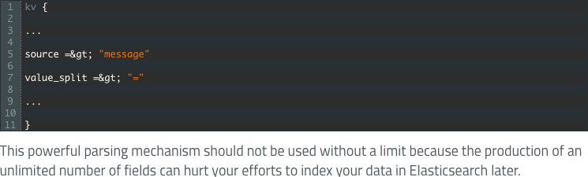
Logstash Plugins – Some Example Filter Plugins
KV
This plugin helps to parse messages automatically and break them down into key value pairs. By default, it will try to parse the message field and look for an ‘=’ delimiter. You can configure any arbitrary strings to split your data on any event field
The configuration options:

Slide 77
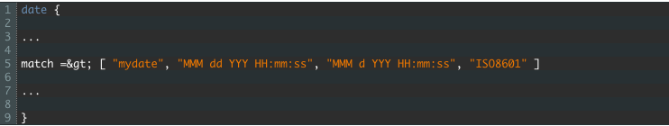
Logstash Plugins – Some Example Filter Plugins
Date
The date plugin is used for parsing dates from fields and then using that date as the logstash @timestamp for the event. It is one of the most important filters that you can use — especially if you use Elasticsearch to store and Kibana to visualize your logs — because Elasticsearch will automatically detect and map that field with the listed type of timestamp.
This plugin ensures that your log events will carry the correct timestamp and not a timestamp based on the first time Logstash sees an event.
The configuration options:
Match — You can specify an array of field name, followed by a date-format pattern. That can help to support fields that have multiple time formats. The date formats allowed are defined by the Java library Joda-Time.
One example:

Slide 78
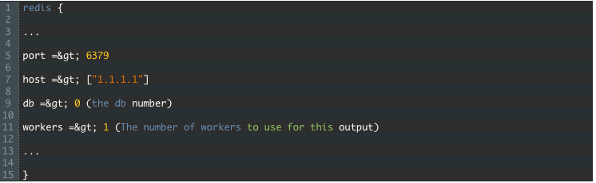
Logstash Plugins – Some Example Output Plugins
Redis
The Redis plugin is used to output events to redis using a RPUSH, Redis is a key-value data store that can serve as a buffer layer in your data pipeline. Usually, you will use Redis as a message queue for Logstash shipping instances that handle data ingestion and storage in the message queue.
The configuration options:

Slide 79
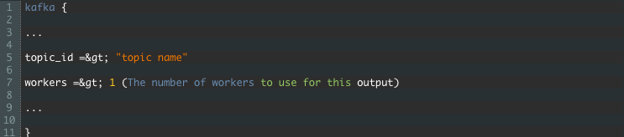
Logstash Plugins – Some Example Output Plugins
Kafka
Kafka is a distributed publish-subscribe messaging system that is designed to be fast, scalable, and durable. Usually, you will use Kafka as a message queue for your Logstash shipping instances that handles data ingestion and storage in the message queue. The Kafka plugin writes events to a Kafka topic and uses the Kafka Producer API to write messages.
The only required configuration is the topic name:

Slide 80
Logstash Plugins – Some Example Output Plugins
Kafka
Kafka is a distributed publish-subscribe messaging system that is designed to be fast, scalable, and durable. Usually, you will use Kafka as a message queue for your Logstash shipping instances that handles data ingestion and storage in the message queue. The Kafka plugin writes events to a Kafka topic and uses the Kafka Producer API to write messages.
The only required configuration is the topic name:

Slide 81
Start Stashing!
The only thing left to do now is to get your hands dirty. This chapter guided you through installing Logstash, configuring it, and making sure that you have access to all the functionality that you need through the plugin ecosystem. Since Logstash is the first element of the ELK stack, you should now have a solid grounding in how to use it for log and time-series data analysis.
Notes:
The input section tells Logstash to pull logs from the Apache access log and specify the type of those events as apache-access. Setting the type is important, as it will be used to selectively apply filters and outputs later on in the event’s lifetime. It’s also used to organize the events when it’s eventually pushed to Elasticsearch.
In the filter section, we specifically apply a grok filter to events that have the apache-access type. This conditional ensures that only the apache-access events get filtered. If it is not there, Logstash will attempt to apply the grok filter to events from other inputs as well. This filter parses the log string and populates the event with the relevant information from the Apache logs.
Lastly, we see the output section. The first conditional ensures, once again, that we only operate on the apache-access events. The next, nested, conditional sends all of the events that didn’t match our grok pattern to the null output. Since they didn’t conform to the specified pattern, we assume that they are log lines that contain information we’re not interested in and discard it. Since order is important in filters and outputs, this will ensure that only events that were successfully parsed will make it to the Elasticsearch output.
Each of the configuration files can contain these three sections. Logstash will typically combine all of our configuration files and consider it as one large config. Since you can have multiple inputs, it’s recommended that you tag your events or assign types to them so that it’s easy to identify them at a later stage. Also ensure that you wrap your filters and outputs that are specific to a category or type of event in a conditional, otherwise you might get some surprising results.

Slide 82
Summary – Module 3: Logstash
Installation
Configuration
Plugins
Lots of Examples

Slide 83
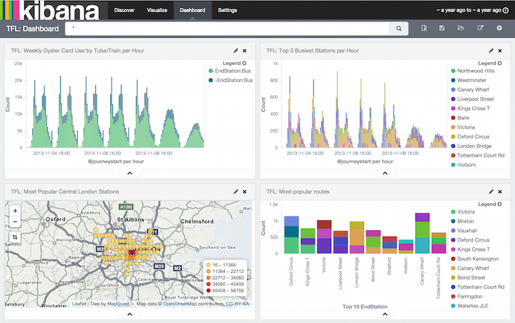
Module 4: Kibana

Slide 84
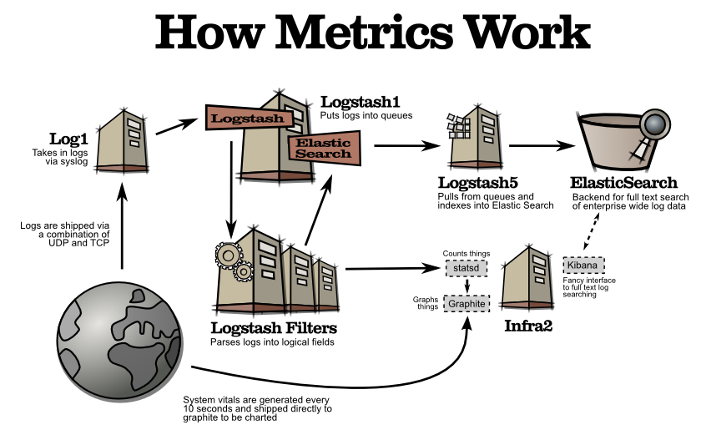
Objectives
Installation
Configuration
Running Kibana
Dashboard

Slide 85
Kibana Installation
Before getting into the wonderful world of the Elasticsearch query language, we would like to introduce you to the simple but pretty flexible URI request search, which allows us to use a simple Elasticsearch query combined with the Lucene query language.
All queries in Elasticsearch are sent to the _search endpoint. You can search a single index or multiple indices, and you can restrict your search to a given document type or multiple types. For example, in order to search our book's index, we will run the following command:

Slide 86
Kibana Configuration
Before getting into the wonderful world of the Elasticsearch query language, we would like to introduce you to the simple but pretty flexible URI request search, which allows us to use a simple Elasticsearch query combined with the Lucene query language.
All queries in Elasticsearch are sent to the _search endpoint. You can search a single index or multiple indices, and you can restrict your search to a given document type or multiple types. For example, in order to search our book's index, we will run the following command:

Slide 87

Kibana Dashboard
A Kibana dashboard displays a set of saved visualizations in groups that you can arrange freely. You can save a dashboard to share or reload at a later time.
You need at least one saved visualization to use a dashboard.

Slide 88
Kibana Loading Data in Kibana
For the purpose of this tutorial, we will use a sample 24-hour period of Apache data (which can be downloaded here) that is being renewed every day. (This means that if you import the data into your ELK Stack, it will present data for today. Then, you can download additional data at that same URL the following day.)
To upload your data, take these steps: (next slide)

Slide 89

Kibana Loading Data in Kibana

Slide 90
Kibana Kibana Search Syntax
Free-Text Search
Free text search works within all fields — including the _source field, which includes all the other fields. If no specific field is indicated in the search, the search will be done on all of the fields that are being analyzed.
Try to run the following searches in the Discovery search field and see what you get (and set the time parameter on the top right of the dashboard to the prior twelve hours to capture more data):
category
Category
categ
cat*
categ?ry
“category”
category\/health
“category/health”
Chrome
chorm*
There are a few things to notice here:
Text searches are not case sensitive. This means that [category] and [CaTeGory] will return the same results. When you put the text within double quotes (“”), you are looking for an exact match, which means that the exact string must match what is inside the double quotes. This is why [category\/health] and [“category/health”] will return different results
You can use the wildcard symbols [*] or [?] in searches. [*] means any number of characters, and [?] means only one character

Slide 91
Kibana Kibana Search Syntax
In Kibana, you can search for data inside specific fields. To do that, you need to use the following format: &lt:fieldname&gt;:search
Run the following searches to see what you get (some will return no results):
geoip.country_name:Canada
name:chrome
name:Chrome
name:Chr*
response:200
bytes:65
bytes:[65 TO *]
bytes:[65 TO 99]
bytes:{65 TO 99}
_exists_:name
There are a few things to notice here:
Field-level searches depend on the type of field. All fields are not analyzed by default, which means that searches are case-sensitive and cannot use wildcard searches. The reason we save all of the fields as “not analyzed” is to save space in the index because the data is also duplicated in an analyzed field called _source
You can search a range within a field. If you use brackets [], this means that the results are inclusive. If you use {}, this means that the results are exclusive
Using the _exists_ prefix for a field will search the documents to see if the field exists
When using a range, you need to follow a very strict format and use capital letters TO to specify the range

Slide 92
Kibana Kibana Search Syntax
Logical Statements
You can use logical statements in searches in these ways:
USA AND Firefox
USA OR Firefox
(USA AND Firefox) OR Windows
-USA
!USA
+USA
NOT USA
There are a few things to understand here:
You need to make sure that you use the proper format such as capital letters to define logical terms like AND or OR
You can use parentheses to define complex, logical statements
You can use -,! and NOT to define negative terms

Slide 93
Kibana Kibana Search Syntax
Escaping special characters
All special characters need to be properly escaped. The following is a list of all available special characters:
+ – && || ! ( ) { } [ ] ^ ” ~ * ? : \

Slide 94
Summary
Installing Kibana
Configuring Kibana
Running Kibana
Dashboard

Slide 95

Day 2 Agenda
Copyright 2013-2016, RX-M LLC
ELK in Production
The Kibana Discover Page
The Visualize Page
Settings and Configuration

Slide 96
Module 5: ELK in Production

Slide 97
Objectives
Save and index all of the log files that it receives (sounds obvious, right?)
Operate when the production system is overloaded or even failing (because that’s when most issues occur, isn’t it?)
Keep the log data protected from unauthorized access
Have maintainable approaches to data retention policies, upgrades, and more

Slide 98
Don’t Lose Log Data
If you are troubleshooting an issue and go over a set of events, it only takes missing one log line to get incorrect results. Every log event must be captured. For example, you’re viewing a set of events in MySQL that ends with a database exception. If you lose one of the events, it might be impossible to pinpoint the cause of the problem.

Slide 99
Use Redis or some other pooling architecture
Place a Redis server in front of your Logstash machine that will be the entry point for all log events that are shipped to your system. It will then buffer the data until the downstream components have enough resources to index. Elasticsearch is the engine at the heart of ELK. It is very susceptible to load, which means you need to be extremely careful when indexing and increasing your amount of documents. When Elasticsearch is busy, Logstash works slower than normal — which is where Redis comes in, accumulating more documents that can then be pushed to Elasticsearch. This is critical not to lose log events.

Slide 100

Keep Track of Logstash/Elasticserch Exceptions

Slide 101
Growth and Bursts of Traffic
Machines pile up, data grows, and log files follow suit. As you scale out with more products, applications, features, developers, and operations, you also accumulate more logs. This requires a certain amount of compute resource and storage capacity so that your system can process all of them.
In general, log management solutions consume large amounts of CPU, memory, and storage. Log systems are bursty by nature, and sporadic bursts are typical. If a file is purged from your database, the frequency of logs that you receive may range from 100 to 200 to 100,000 logs per second.
As a result, you need to allocate up to 10 times more capacity than normal. When there is a real production issue, many systems generally report failures or disconnections, which cause them to generate many more logs. This is actually when log management systems are needed more than ever.

Slide 102
ELK Elasticity
One of the biggest challenges of building an ELK deployment, then, is making it scalable. Let’s say you have an e-commerce site and experience an increasing number of incoming log files during a particular time of year. To ensure that this influx of log data does not become a bottleneck, you need to make sure that your environment can scale with ease. This requires that you scale on all fronts — from Redis to Logstash and Elasticsearch — which is challenging in multiple ways. Regardless of where you’re deploying your ELK platform — be it on Amazon Web Services, in the Google Cloud, or in your own datacenter — we recommend having a cluster of Elasticsearch nodes that run in different availability zones, or in different segments of a datacenter, to ensure high availability.
Let’s discuss it one component at a time.

Slide 103
Redis
You probably want to run more than one Redis server, an action that requires some work. You can either build it on you own or run Redis Labs as a service. The only challenge is dividing inbound log traffic from UDP/TCP across multiple Redis servers. For this, we use AWS Route 53 and will share some more about this in the future.

Slide 104
Logstash
To read and push to Elasticsearch, it’s best to use a Logstash instance for each Redis server. That’s easy. Each one of your Logstash instances should run in a different AZ (on AWS). You should also separate Logstash and Elasticsearch by using different machines for them. This is critical because they both run as JVMs and consume large amounts of memory, which makes them unable to run on the same machine effectively. I also recommend allocating half of the memory on each machine to Elasticsearch or Logstash.

Slide 105
Elasticsearch Cluster
Elasticsearch is composed of a number of different components, two of which are the most important: the master nodes and the data nodes. The master nodes are responsible for cluster management while the data nodes, as the name suggests, are in charge of the data. We recommend clustering Elasticsearch with at least three master nodes because of the common occurrence of split brain, which is essentially a dispute between two nodes regarding which one is actually the master. As a result, using three master nodes prevents split brain from happening. As far as the data nodes go, we recommend having at least two data nodes so that your data is replicated at least once. This results in a minimum of five nodes: the three master nodes can be small machines, and the two data nodes need to be scaled on solid machines with very fast storage and a large capacity for memory.

Slide 106
Access Control
Due to the fact that logs may contain sensitive data, it is crucial to protect who can see what. How can you limit access to specific dashboards, visualizations, or data inside your log analytics platform? As far as we know, there is no simple way to do this in the ELK Stack. One option is to use nginx reverse proxy to access your Kibana dashboard, which entails a simple nginx configuration that requires those who want to access the dashboard to have a username and password. This quickly blocks access to your Kibana console.
The challenge here arises if you would like to limit access on a more granular level. This is currently impossible within open source ELK. The only thing you can do is use Elasticsearch Shield and build the security from Elasticsearch up the stack.
Last but not least, be careful when exposing Elasticsearch because it is very susceptible to attacks. We recommend limiting all access to Elasticsearch inbound port 9200 from the internet.

Slide 107
Log Data Consistency
Logstash has a component that parses logs and tokenizes them in accordance with a set of rules. Therefore, if you have an access log from nginx, you want the ability to view each field and have visualizations and dashboards built based on specific fields. You need to apply the relevant parsing abilities to Logstash — which has proven to be quite a challenge, particularly when it comes to building groks, debugging them, and actually parsing logs to have the relevant fields for Elasticsearch and Kibana.
At the end of the day, it is very easy to make mistakes using Logstash, which is why you should carefully test and maintain all of your log configurations by means of version control. That way, while you may get started using nginx and MySQL, you may incorporate custom applications as you grow that result in large and hard-to-manage log files. The community has generated a lot of solutions around this topic, but trial and error is extremely important with open source tools before using them in production.

Slide 108
Data Retention
Another aspect of maintainability comes into play with excess indices. Depending on how long you want to retain data, you need to have a process set up that will automatically delete old indices — otherwise, you will be left with too much data and your Elasticsearch will crash, resulting in data loss. To prevent this from happening, you can use Elasticsearch Curator to delete indices. We recommend having a cron job that automatically spawns Curator with the relevant parameters to delete any old indices, ensuring you don’t end up holding too much data. It is commonly required to save logs to S3 in a bucket for compliance, so you want to be sure to have a copy of the logs in their original format. Copying should be done before logs are parsed by Logstash.

Slide 109
Component Upgrades
Performing Elasticsearch upgrades can be an endeavor on its own. First and foremost, you don’t want to lose any data in the lengthy process. New versions are released every few weeks, so pay careful attention to the upgrade process if you choose to go that route. Make sure you have at least one replication on Elasticsearch and perform warm upgrades (sync data and upgrade one node at a time).
Logstash upgrades are generally easier, but pay close attention to the compatibility between Logstash and Elasticsearch.
Kibana upgrades are hard, but possible. Kibana 3 does not have an upgrade path to Kibana 4. We’ve just met a user who has 600 different Kibana 3 dashboards and now has to rewrite them to use Kibana 4. I guess that’s one of the drawbacks of free open-source solutions.

Slide 110
Summary
Installing Kibana
Configuring Kibana
Running Kibana
Dashboard

Slide 111

Module 6: Kibana Discover Page

Slide 112
Objectives
Time Filter
Search
More Filters

Slide 113
Discover
You can interactively explore your data from the Discover page. You have access to every document in every index that matches the selected index pattern. You can submit search queries, filter the search results, and view document data. You can also see the number of documents that match the search query and get field value statistics. If a time field is configured for the selected index pattern, the distribution of documents over time is displayed in a histogram at the top of the page.

Slide 114

Setting the Time Filter
The Time Filter restricts the search results to a specific time period. You can set a time filter if your index contains time-based events and a time-field is configured for the selected index pattern.
By default the time filter is set to the last 15 minutes. You can use the Time Picker to change the time filter or select a specific time interval or time range in the histogram at the top of the page.
To set a time filter with the Time Picker:
Click the Time Filter displayed in the upper right corner of the menu bar to open the Time Picker.
To set a quick filter, simply click one of the shortcut links.
To specify a relative Time Filter, click Relative and enter the relative start time. You can specify the relative start time as any number of seconds, minutes, hours, days, months, or years ago.
To specify an absolute Time Filter, click Absolute and enter the start date in the From field and the end date in the To field.
Click the caret at the bottom of the Time Picker to hide it.

Slide 115
Searching your Data
You can search the indices that match the current index pattern by submitting a search from the Discover page. You can enter simple query strings, use the Lucene query syntax, or use the full JSON-based Elasticsearch Query DSL.
When you submit a search, the histogram, Documents table, and Fields list are updated to reflect the search results. The total number of hits (matching documents) is shown in the upper right corner of the histogram. The Documents table shows the first five hundred hits. By default, the hits are listed in reverse chronological order, with the newest documents shown first. You can reverse the sort order by by clicking on the Time column header. You can also sort the table using the values in any indexed field. For more information, see Sorting the Documents Table.

Slide 116

Searching your Data
To search your data:
Enter a query string in the Search field:
To perform a free text search, simply enter a text string. For example, if you’re searching web server logs, you could enter safari to search all fields for the term safari.
To search for a value in a specific field, you prefix the value with the name of the field. For example, you could enter status:200 to limit the results to entries that contain the value 200 in the status field.
To search for a range of values, you can use the bracketed range syntax, [START_VALUE TO END_VALUE]. For example, to find entries that have 4xx status codes, you could enter status:[400 TO 499].
To specify more complex search criteria, you can use the Boolean operators AND, OR, and NOT. For example, to find entries that have 4xx status codes and have an extension of php or html, you could enter status:[400 TO 499] AND (extension:php OR extension:html).

Slide 117

Starting a New Search
To clear the current search and start a new search, click the New Search button in the Discover toolbar.

Slide 118
Saving a Search
You can reload saved searches on the Discover page and use them as the basis of visualizations. Saving a search saves both the search query string and the currently selected index pattern.
To save the current search:
Click the Save Search button in the Discover toolbar.
Enter a name for the search and click Save.

Slide 119
Loading a Saved Search
To load a saved search:
Click the Load Search button in the Discover toolbar.
Select the search you want to load.

Slide 120
Changing Searched Indices
When you submit a search request, the indices that match the currently-selected index pattern are searched. The current index pattern is shown below the search field. To change which indices you are searching, click the name of the current index pattern to display a list of the configured index patterns and select a different index pattern.
For more information about index patterns, see Creating an Index Pattern.

Slide 121

Automatically Refresh
You can configure a refresh interval to automatically refresh the page with the latest index data. This periodically resubmits the search query.
When a refresh interval is set, it is displayed to the left of the Time Filter in the menu bar.

Slide 122

Filtering by Field
You can filter the search results to display only those documents that contain a particular value in a field. You can also create negative filters that exclude documents that contain the specified field value.
You can add filters from the Fields list or from the Documents table. When you add a filter, it is displayed in the filter bar below the search query. From the filter bar, you can enable or disable a filter, invert the filter (change it from a positive filter to a negative filter and vice-versa), toggle the filter on or off, or remove it entirely. Click the small left-facing arrow to the right of the index pattern selection drop-down to collapse the Fields list.

Slide 123

Filtering by Field

Slide 124

Working with Filters

Slide 125

Working with Filters

Slide 126

Working with Filters

Slide 127
Summary
Time Filter
Search
More Filters

Slide 128
Module 7: Visualize and Dashboard pages

Slide 129
Objectives
Visualizations and Editor
Area Charts
Data Tables
Line Charts
Pie Charts
Tile Maps
Metric Visualization
Vertical Bar Charts
Dashboard

Slide 130
Visualize
You can use the Visualize page to design data visualizations. You can save these visualizations, use them individually, or combine visualizations into a dashboard. A visualization can be based on one of the following data source types:
A new interactive search
A saved search
An existing saved visualization
Visualizations are based on the aggregation feature introduced in Elasticsearch 1.x.

Slide 131

Creating a new Visualization

Slide 132
Creating a new Visualization
Step 2: Choose a Data Sourceedit
You can choose a new or saved search to serve as the data source for your visualization. Searches are associated with an index or a set of indexes. When you select new search on a system with multiple indices configured, select an index pattern from the drop-down to bring up the visualization editor.
When you create a visualization from a saved search and save the visualization, the search is tied to the visualization. When you make changes to the search that is linked to the visualization, the visualization updates automaticall

Slide 133

Creating a new Visualization
Step 3: The Visualization Editoredit
The visualization editor enables you to configure and edit visualizations. The visualization editor has the following main elements:
Toolbar
Aggregation Builder
Preview Canvas

Slide 134

Automatically Refreshing

Slide 135
Toolbar
The toolbar has a search field for interactive data searches, as well as controls to manage saving and loading visualizations. For visualizations based on saved searches, the search bar is grayed out. To edit the search, replacing the saved search with the edited version, double-click the search field.
The toolbar at the right of the search box has buttons for creating new visualizations, saving the current visualization, loading an existing visualization, sharing or embedding the visualization, and refreshing the data for the current visualization.

Slide 136
Aggregation Builder
Use the aggregation builder on the left of the page to configure the metric and bucket aggregations used in your visualization. Buckets are analogous to SQL GROUP BY statements. For more information on aggregations, see the main Elasticsearch aggregations reference.
Bar, line, or area chart visualizations use metrics for the y-axis and buckets are used for the x-axis, segment bar colors, and row/column splits. For pie charts, use the metric for the slice size and the bucket for the number of slices.
Choose the metric aggregation for your visualization’s Y axis, such as count, average, sum, min, max, or cardinality (unique count). Use bucket aggregations for the visualization’s X axis, color slices, and row/column splits. Common bucket aggregations include date histogram, range, terms, filters, and significant terms.
You can set the order in which buckets execute. In Elasticsearch, the first aggregation determines the data set for any subsequent aggregations. The following example involves a date bar chart of Web page hits for the top 5 file extensions.

Slide 137
Aggregation Builder
Use the aggregation builder on the left of the page to configure the metric and bucket aggregations used in your visualization. Buckets are analogous to SQL GROUP BY statements. For more information on aggregations, see the main Elasticsearch aggregations reference.
Bar, line, or area chart visualizations use metrics for the y-axis and buckets are used for the x-axis, segment bar colors, and row/column splits. For pie charts, use the metric for the slice size and the bucket for the number of slices.
Choose the metric aggregation for your visualization’s Y axis, such as count, average, sum, min, max, or cardinality (unique count). Use bucket aggregations for the visualization’s X axis, color slices, and row/column splits. Common bucket aggregations include date histogram, range, terms, filters, and significant terms.

Slide 138

Working with Filters

Slide 139
Area Charts – Y Axis
This chart’s Y axis is the metrics axis. The following aggregations are available for this axis:
Count-The count aggregation returns a raw count of the elements in the selected index pattern.
Average-This aggregation returns the average of a numeric field. Select a field from the drop-down.
Sum-The sum aggregation returns the total sum of a numeric field. Select a field from the drop-down.
Min-The min aggregation returns the minimum value of a numeric field. Select a field from the drop-down.
Max-The max aggregation returns the maximum value of a numeric field. Select a field from the drop-down.
Unique Count-The cardinality aggregation returns the number of unique values in a field. Select a field from the drop-down.
Percentiles-The percentile aggregation divides the values in a numeric field into percentile bands that you specify. Select a field from the drop-down, then specify one or more ranges in the Percentiles fields. Click the X to remove a percentile field. Click + Add to add a percentile field.
Percentile Rank-The percentile ranks aggregation returns the percentile rankings for the values in the numeric field you specify. Select a numeric field from the drop-down, then specify one or more percentile rank values in the Values fields. Click the X to remove a values field. Click +Add to add a values field.

Slide 140

Area Charts – X Axis
Notes:
You can add an aggregation by clicking the + Add Aggregation button.
The X axis of this chart is the buckets axis. You can define buckets for the X axis, for a split area on the chart, or for split charts.
This chart’s X axis supports the following aggregations. Click the linked name of each aggregation to visit the main Elasticsearch documentation for that aggregation.
Once you’ve specified an X axis aggregation, you can define sub-aggregations to refine the visualization. Click + Add Sub Aggregation to define a sub-aggregation, then choose Split Area or Split Chart, then select a sub-aggregation from the list of types.
When multiple aggregations are defined on a chart’s axis, you can use the up or down arrows to the right of the aggregation’s type to change the aggregation’s priority.
https://www.elastic.co/guide/en/kibana/4.6/area-chart.html

Slide 141
Data Table – Y Axis
Count-The count aggregation returns a raw count of the elements in the selected index pattern.
Average-his aggregation returns the average of a numeric field. Select a field from the drop-down.
Sum-The sum aggregation returns the total sum of a numeric field. Select a field from the drop-down.
Min-The min aggregation returns the minimum value of a numeric field. Select a field from the drop-down.
Max-The max aggregation returns the maximum value of a numeric field. Select a field from the drop-down.Unique CountThe cardinality aggregation returns the number of unique values in a field. Select a field from the drop-down.
Standard Deviation-The extended stats aggregation returns the standard deviation of data in a numeric field. Select a field from the drop-down.
Percentiles-The percentile aggregation divides the values in a numeric field into percentile bands that you specify. Select a field from the drop-down, then specify one or more ranges in the Percentiles fields. Click the X to remove a percentile field. Click + Add to add a percentile field.
Percentile Rank-The percentile ranks aggregation returns the percentile rankings for the values in the numeric field you specify. Select a numeric field from the drop-down, then specify one or more percentile rank values in the Values fields. Click the X to remove a values field. Click +Add to add a values field.
Notes:
You can add an aggregation by clicking the + Add Aggregation button.
Enter a string in the Custom Label field to change the display label.
The rows of the data table are called buckets. You can define buckets to split the table into rows or to split the table into additional tables.

Slide 142

Data Tables– X Axis
Notes:
Once you’ve specified a bucket type aggregation, you can define sub-aggregations to refine the visualization. Click + Add Sub Aggregation to define a sub-aggregation, then choose Split Rows or Split Table, then select a sub-aggregation from the list of types.
You can use the up or down arrows to the right of the aggregation’s type to change the aggregation’s priority.
https://www.elastic.co/guide/en/kibana/4.6/data-table.html

Slide 143
Line Charts– Y Axis
This chart’s Y axis is the metrics axis. The following aggregations are available for this axis:
Count-The count aggregation returns a raw count of the elements in the selected index pattern.
Average-This aggregation returns the average of a numeric field. Select a field from the drop-down.
Sum-The sum aggregation returns the total sum of a numeric field. Select a field from the drop-down.
Min-The min aggregation returns the minimum value of a numeric field. Select a field from the drop-down.
Max-The max aggregation returns the maximum value of a numeric field. Select a field from the drop-down.
Unique Count-The cardinality aggregation returns the number of unique values in a field. Select a field from the drop-down.
Standard Deviation-The extended stats aggregation returns the standard deviation of data in a numeric field. Select a field from the drop-down.
Percentiles-The percentile aggregation divides the values in a numeric field into percentile bands that you specify. Select a field from the drop-down, then specify one or more ranges in the Percentiles fields. Click the X to remove a percentile field. Click + Add to add a percentile field.
Percentile Rank-The percentile ranks aggregation returns the percentile rankings for the values in the numeric field you specify. Select a numeric field from the drop-down, then specify one or more percentile rank values in the Values fields. Click the X to remove a values field. Click +Add to add a values field.

Slide 144
Line Charts– X Axis
Notes:
Once you’ve specified a bucket type aggregation, you can define sub-aggregations to refine the visualization. Click + Add Sub Aggregation to define a sub-aggregation, then choose Split Rows or Split Table, then select a sub-aggregation from the list of types.
You can use the up or down arrows to the right of the aggregation’s type to change the aggregation’s priority.
https://www.elastic.co/guide/en/kibana/4.6/data-table.html

Slide 145
Line Charts– X Axis
Markdown Widgets
Metrics
Pie Charts
Tile Maps
Vertical Bar Charts
Notes:
https://www.elastic.co/guide/en/kibana/4.6/visualize.html

Slide 146
Kibana Dashboard
A Kibana dashboard displays a set of saved visualizations in groups that you can arrange freely. You can save a dashboard to share or reload at a later time.
You need at least one saved visualization to use a dashboard.

Slide 147

Kibana Building a New Dashboard
The first time you click the Dashboard tab, Kibana displays an empty dashboard.

Slide 148
Kibana Customizing Dashboard Elements
The visualizations in your dashboard are stored in resizable containers that you can arrange on the dashboard. This section discusses customizing these containers.
Moving Containersedit
Click and hold a container’s header to move the container around the dashboard. Other containers will shift as needed to make room for the moving container. Release the mouse button to confirm the container’s new location.
Resizing Containersedit
Move the cursor to the bottom right corner of the container until the cursor changes to point at the corner. After the cursor changes, click and drag the corner of the container to change the container’s size. Release the mouse button to confirm the new container size.
Removing Containersedit
Click the x icon at the top right corner of a container to remove that container from the dashboard. Removing a container from a dashboard does not delete the saved visualization in that container.

Slide 149

Kibana Building a New Dashboard

Slide 150
Summary
Visualizations and Editor
Area Charts
Data Tables
Line Charts
Pie Charts
Tile Maps
Metric Visualization
Vertical Bar Charts
Dashboard

Slide 151
Module 8: Kibana Settings and Configuration

Slide 152
Objectives
The Settings Page
Advanced
Objects
About

Slide 153

Exploring the Settings Page
The Settings page is one of the pages present in Kibana 4 that helps you customize and tweak the various settings provided in order to use Kibana efficiently. This page gives you a full overview of the different types of indices present wherein you can configure as many index patterns as you want, followed by the advanced settings in which, settings that are either undocumented, unsupported, or experimental can be tweaked, along with managing and editing saved objects such as Dashboards, Searches, and Visualizations.
The Settings page contains the following tabs:
Indices
Advanced
Objects
About

Slide 154
The Indices Tab
The Indices tab is used to edit settings related to the index. Within this tab, you can configure/add an index pattern, set any index as default, and remove the index pattern. You can also view information related to every field and edit the field properties.

Slide 155

Configuring an Index Pattern
Indices is the default tab that opens whenever you start Kibana or click on the Settings page. As Elasticsearch uses an index to process data, it remains the most important component, without which we cannot analyze data, create visualizations, or build dashboards. Index is the heart of Elasticsearch and Kibana.
It displays the following information when opened:

Slide 156

Configuring an Index Pattern
You can also use the date format pattern to add indices that have the event times/timestamp attached to it.
For example, suppose you have indices such as kibana1-2015-08-12, kibana1-2015-07-27, and kibana1-2015-06-02.
To define the event times, tick the Use event times to create index names option. Upon clicking on it, you will see the following options to define:

Slide 157

Configuring an Index Pattern
In this, you can define Index pattern interval, which defines how frequently the index is created and can be chosen as Hourly, Daily, Weekly, Monthly, or Yearly.
Then, define the index pattern as [kibana1-]YYYY-MM-DD, which will read all the aforementioned indices and add them for use in Kibana:

Slide 158

Configuring an Index Pattern
For additional properties related to an index, click on the index to view the following options:

Slide 159
Other Indices Actions
Setting the Default Pattern
Reloading the Index fields list
Removing an index pattern
Manageing the Field Properties

Slide 160

The Advanced Tab - Settings
This tab is for advanced users. It provides the options of editing the settings that directly control the Kibana application. The settings can be undocumented, unsupported, or experimental. Tweaking the settings can cause unexpected behavior.

Slide 161

The Advanced Tab - Settings

Slide 162

The Advanced Tab - Settings
Changing the csv:separator option: This is used to separate exported values. By default, it is , (comma); change it to : (colon).
Changing the csv:quoteValues option: This is used to define whether the value should be quoted when CSV is exported. The default is true; change it to false.
Now open the saved Data Table visualization and export the data in the Raw format.
The screenshot to the left was obtained using the default options, while the screenshot to the right was obtained after changing the default options:

Slide 163

The Objects Tab - Settings
This tab is used to view, edit, delete, export, and import saved objects, such as saved searches, saved visualizations, and saved dashboards.
Managing saved searches, visualizations, and dashboards
This provides an advanced setting in which modification of an existing saved object can be done. It enhances the reusability of created searches, visualizations, or dashboards. The objects can be viewed, edited, deleted, exported, or imported into Kibana. To manage saved objects, go to Settings | Objects. The following page will be displayed:

Slide 164
The Objects Tab - Settings
VIEWING A SAVED OBJECT
In this setting, it provides a single page to view all the saved objects. The saved objects can be viewed in the Objects tab which is under the Settings page. If you have saved a search in the Discover page, it will be listed inside the Searches tab. If you have saved a visualization in the Visualize page, it will be listed inside the Visualizations tab. If you have saved a dashboard in the Dashboard page, it will be listed inside the Dashboards tab.
To view a saved object, follow these steps:
Click on the Settings tab, followed by the Objects tab.
All the saved objects will be displayed within the respective tabs.
Click on the selection box to select the object that you want to view.
Click on the view button

Slide 165
The Objects Tab - Settings
Editing a saved object
With the setting of editing a saved object, kibana provides the flexibility to directly alter the object description, the object metadata, the object saved name, and the JSON that specifies all the properties of the object.
To edit a saved object, perform the following steps:
Click on the settings tab, followed by the objects tab.
All the saved objects will be displayed within the respective tabs.
Click on the selection box to select the object that you want to edit.
Then click on the edit button editing a saved object.
Make changes to the object name, description, metadata, or object properties.
Click on the save object button editing a saved object.

Slide 166
The Objects Tab - Settings
DELETING A SAVED OBJECT
With this setting, you can delete any created or saved object. It provides an easy way to directly delete saved objects.
To delete a saved object, follow these steps:
Click on the Settings tab and then on the Objects tab.
All the saved objects will be displayed within the respective tabs.
Click on the selection box to select the object that you want to delete.
Then click on the delete button Deleting a saved object.

Slide 167
The Objects Tab - Settings
EXPORTING SAVED OBJECTS
Once you do this setting, you can easily export saved objects and they can be reused whenever needed. By exporting saved objects, a backup can easily be maintained, which can be used if the object gets deleted or corrupted.
To export a saved object, perform the following steps:
Again, click on the Settings tab and then on the Objects tab.
All the saved objects will be displayed within the respective tabs.
Click on the selection box to select the object that you want to export.
Click on the export button Exporting saved objects and specify the location to save the object exported in JSON format at.

Slide 168
The Objects Tab - Settings
IMPORTING SAVED OBJECTS
With this setting you can easily import saved objects providing the ability to reuse whenever needed.
To import saved objects:
Click on the Settings tab, followed by the Objects tab.
Click on the import button to import the saved object.
Specify the filename to be imported, which contains the saved object JSON data.
Click on Open after choosing the file.

Slide 169

The About Tab - Settings

Slide 170
Summary
Settings
Indices
Advanced
Objects
About

